Slide 1
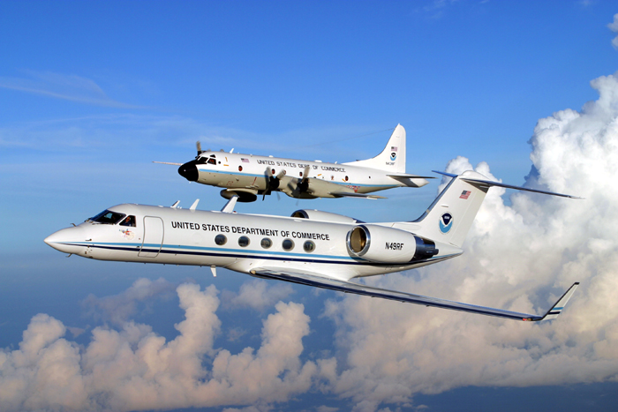
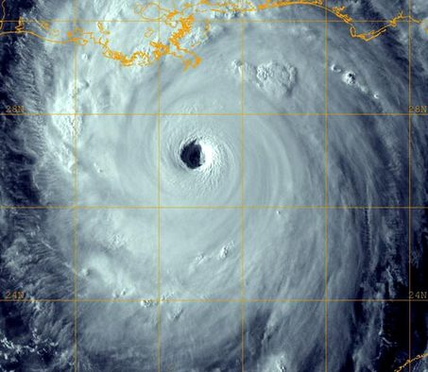
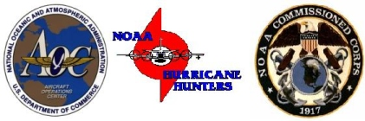
NOAA Aircraft Operations Center
Richard Henning, Barry Damiano
Flight Meteorologists
www.aoc.noaa.gov

Slide 2


Slide 3
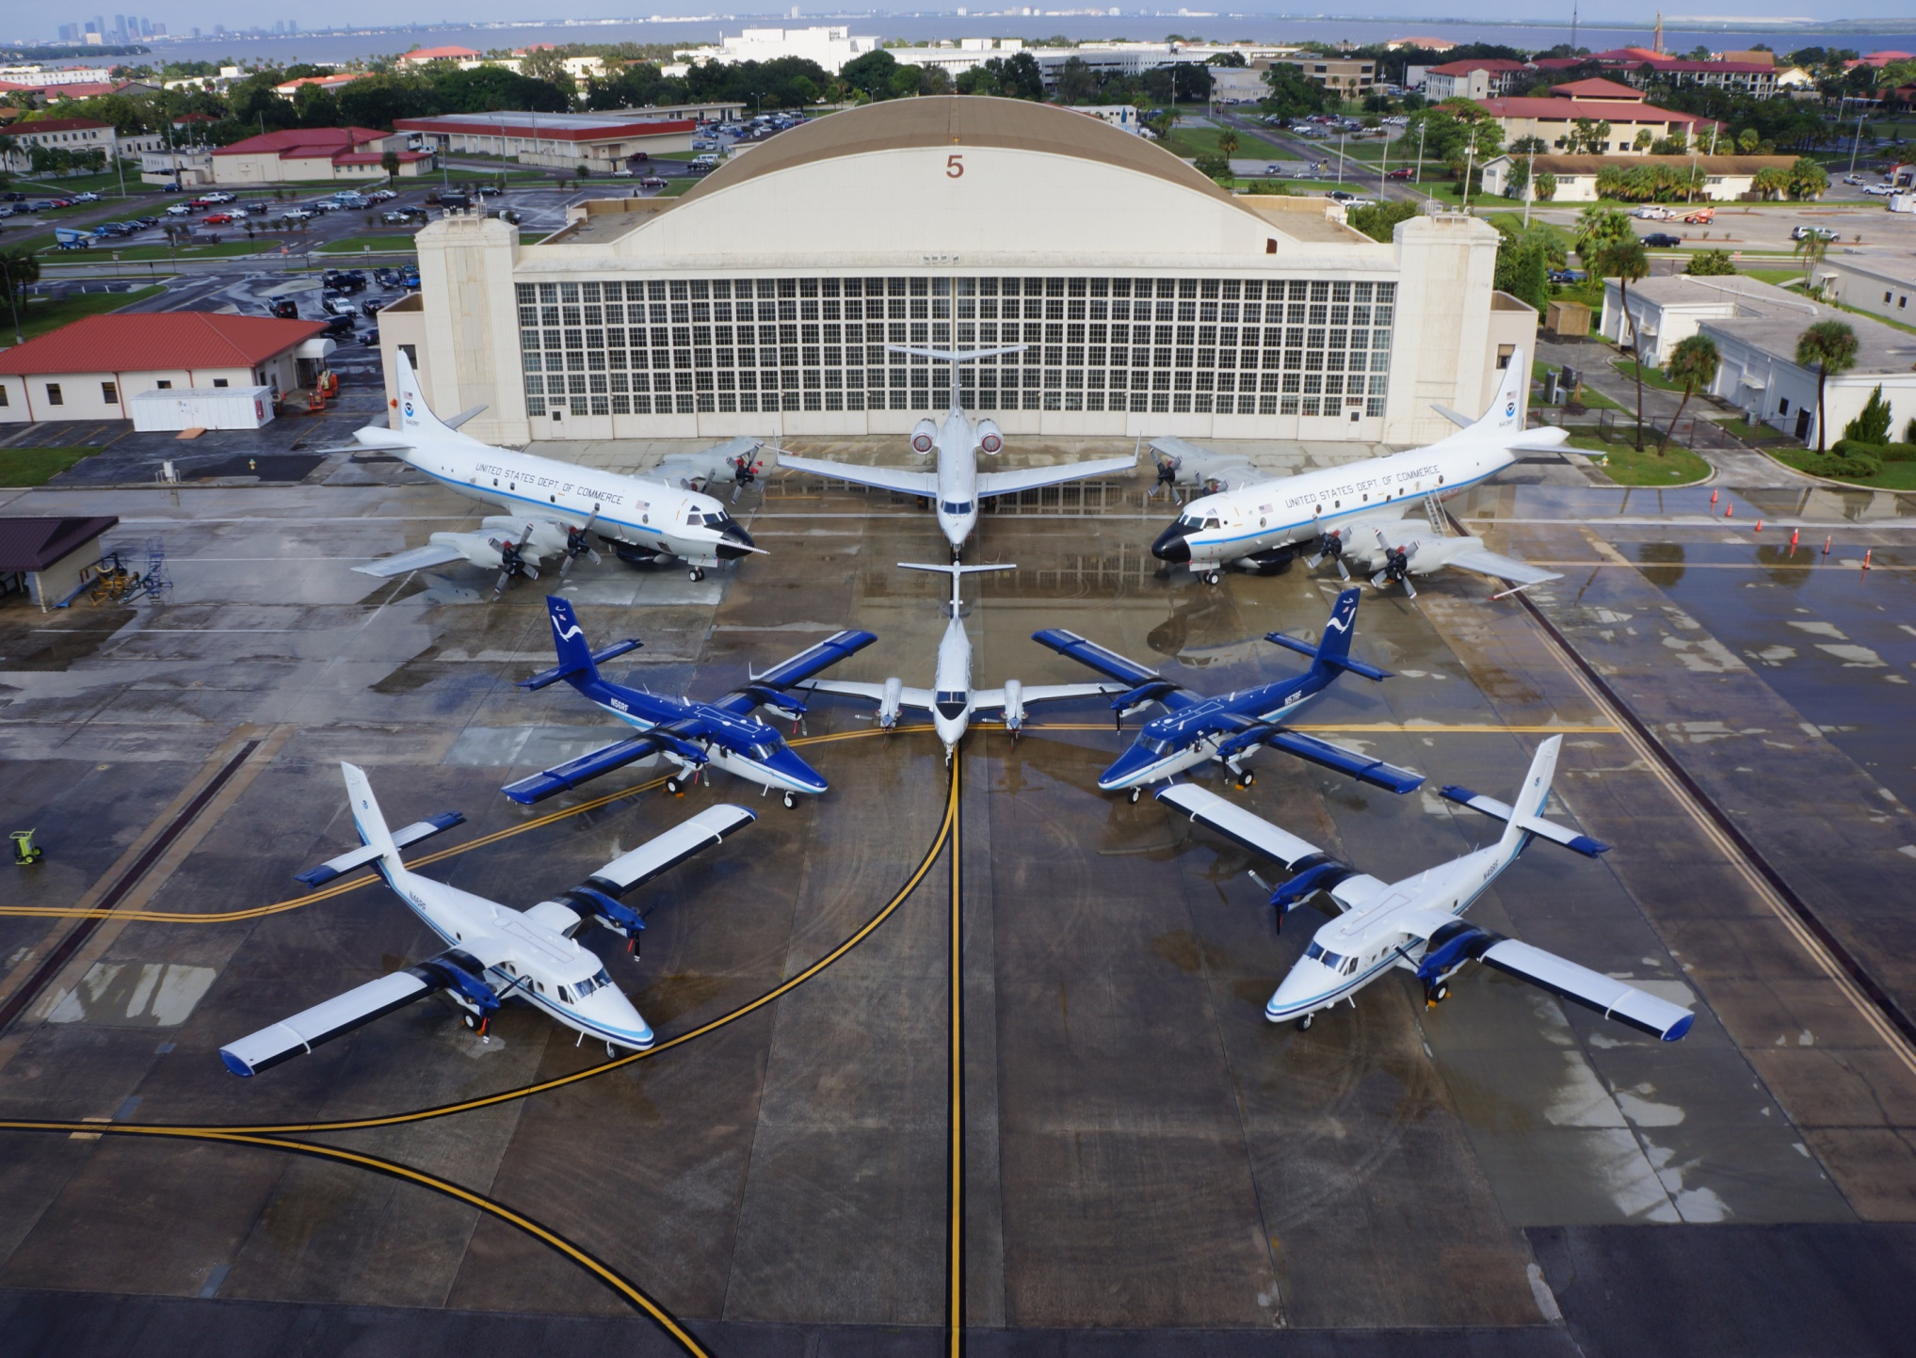
NOAA Aircraft Operations Center
MacDill AFB Tampa Florida

Slide 4
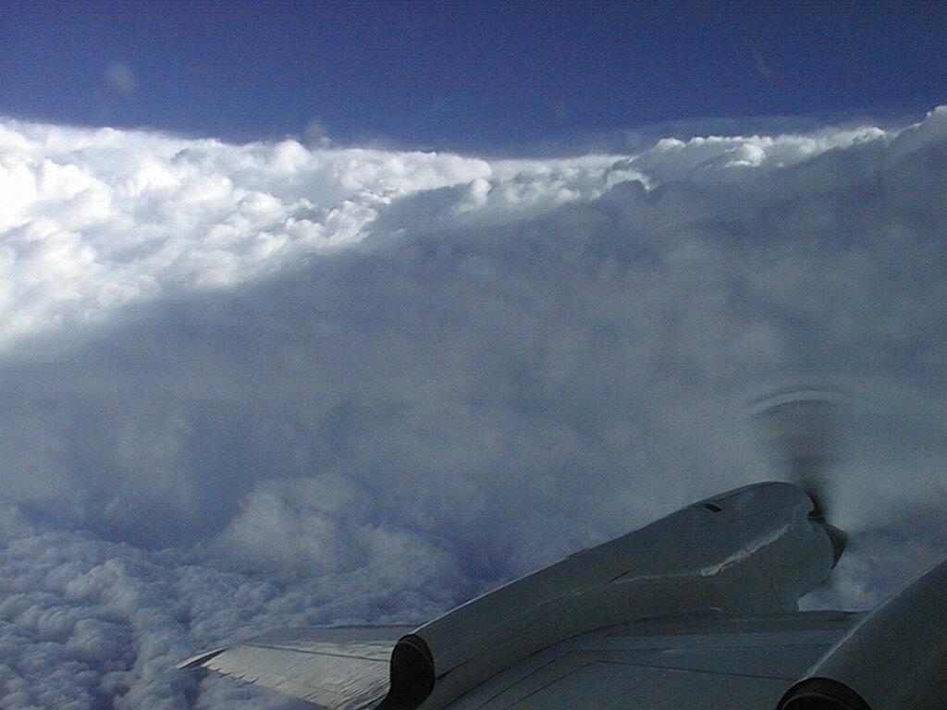
Hurricane Operations

Slide 5
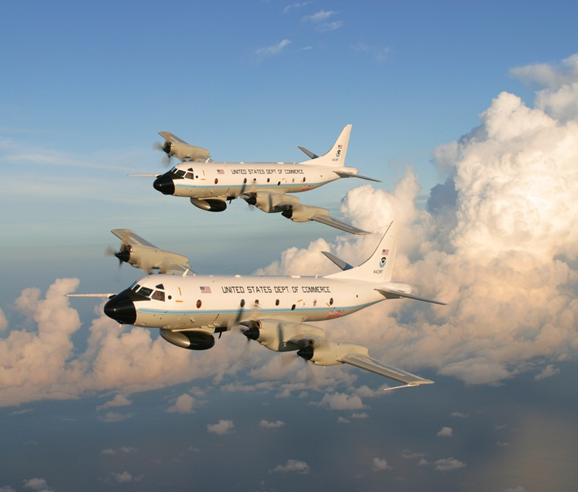
NOAA WP-3 Orions
*Hurricane Hunters
*Flies inside the storm
*Crew of 18 includes pilots, engineers, navigators, and scientists
*Uses dropsondes and radar to gather data

Slide 6
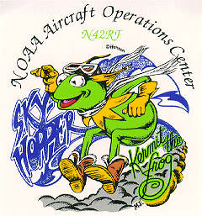
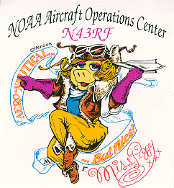
Kermit Miss Piggy

Slide 7
HURRICANE
KATRINA

Slide 8
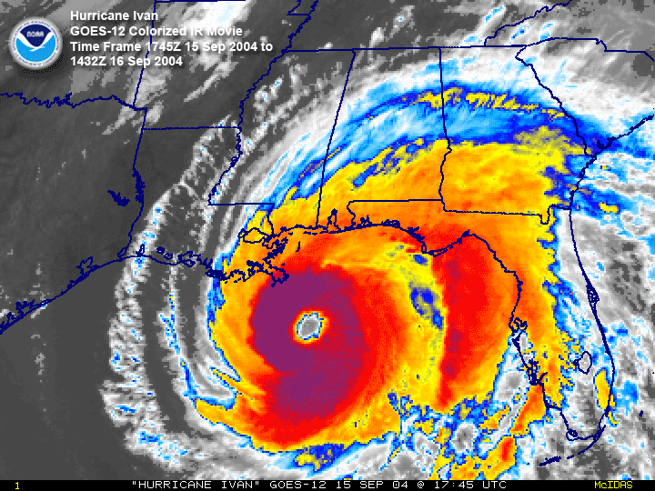

Slide 9
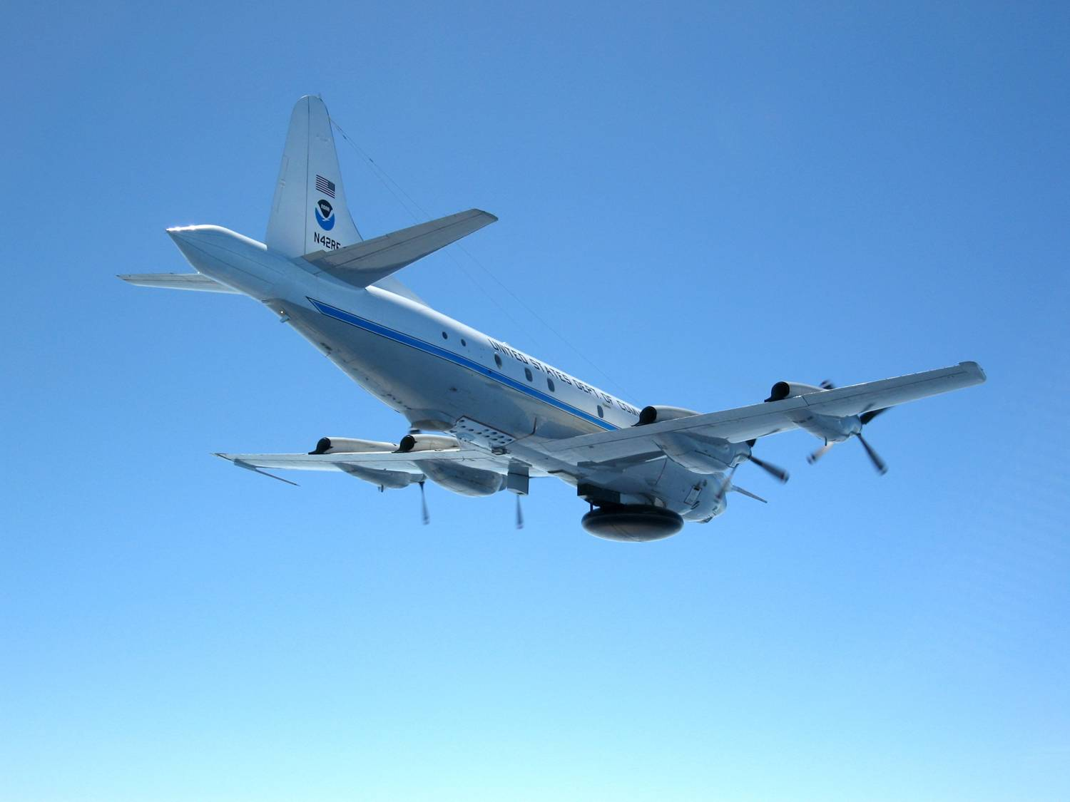
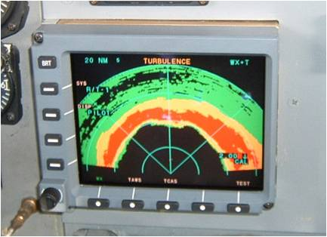
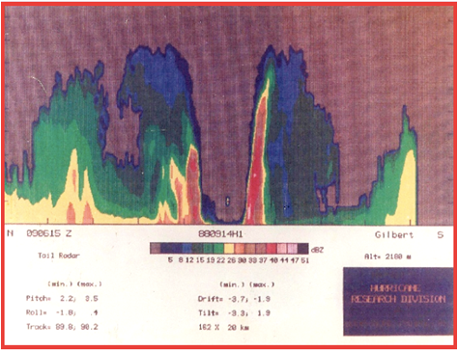
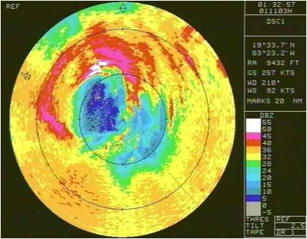
P-3 Radar
Nose Radar
Tail Doppler Radar
Lower
Fuselage
Radar

Slide 10
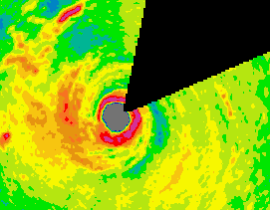
Lower Fuselage radar showing the
eye and eyewall of Hurricane Felix
Over the Caribbean Sea in 2007

Slide 11
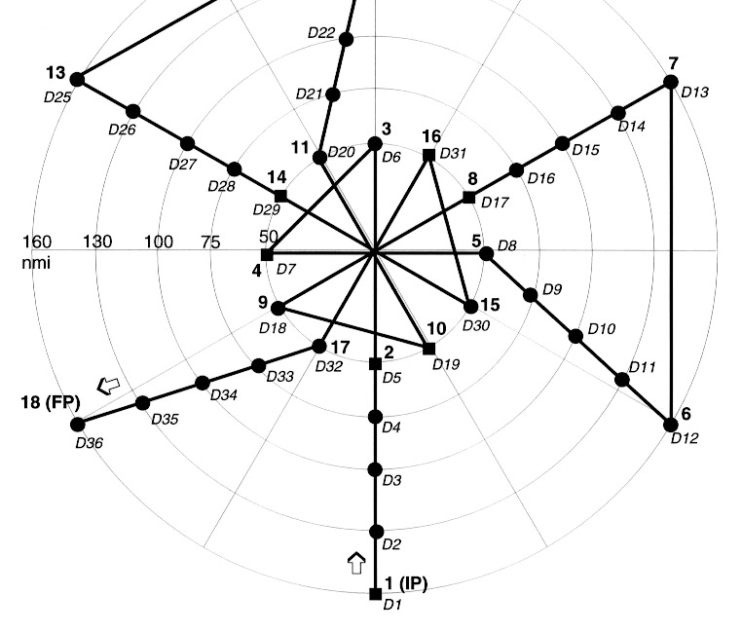
Figure 4 Pattern

Slide 12
Flight Through Eyewall
EYEWALL
EYE
AIRCRAFT TRACK
3 km
DROPSONDE TRAJECTORY
100
90
80
70
~2-3 km

Slide 13
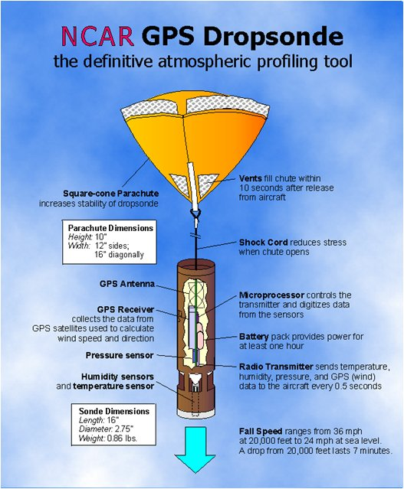

Slide 14
Coyote: Small unmanned aircraft released into the hurricane from the P-3

Slide 15
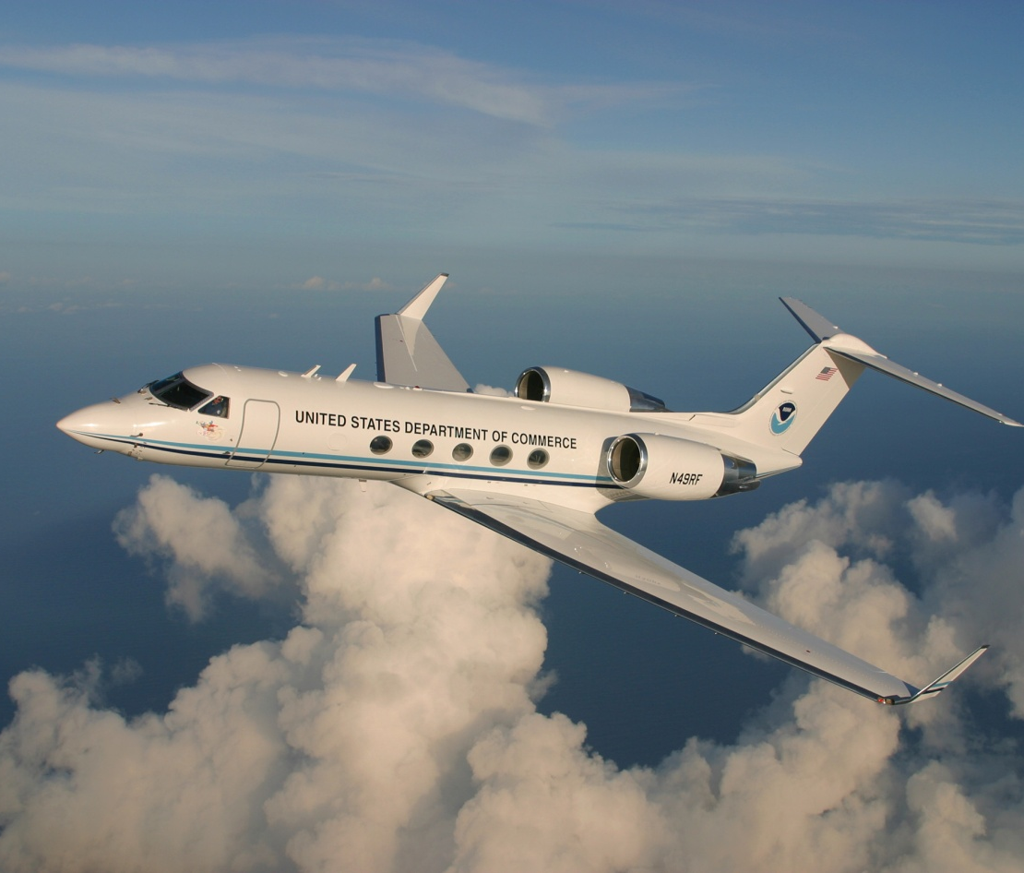

NOAA G-IV
*Also a Hurricane Hunter
*Flies above the storm at 45,000ft

Slide 16
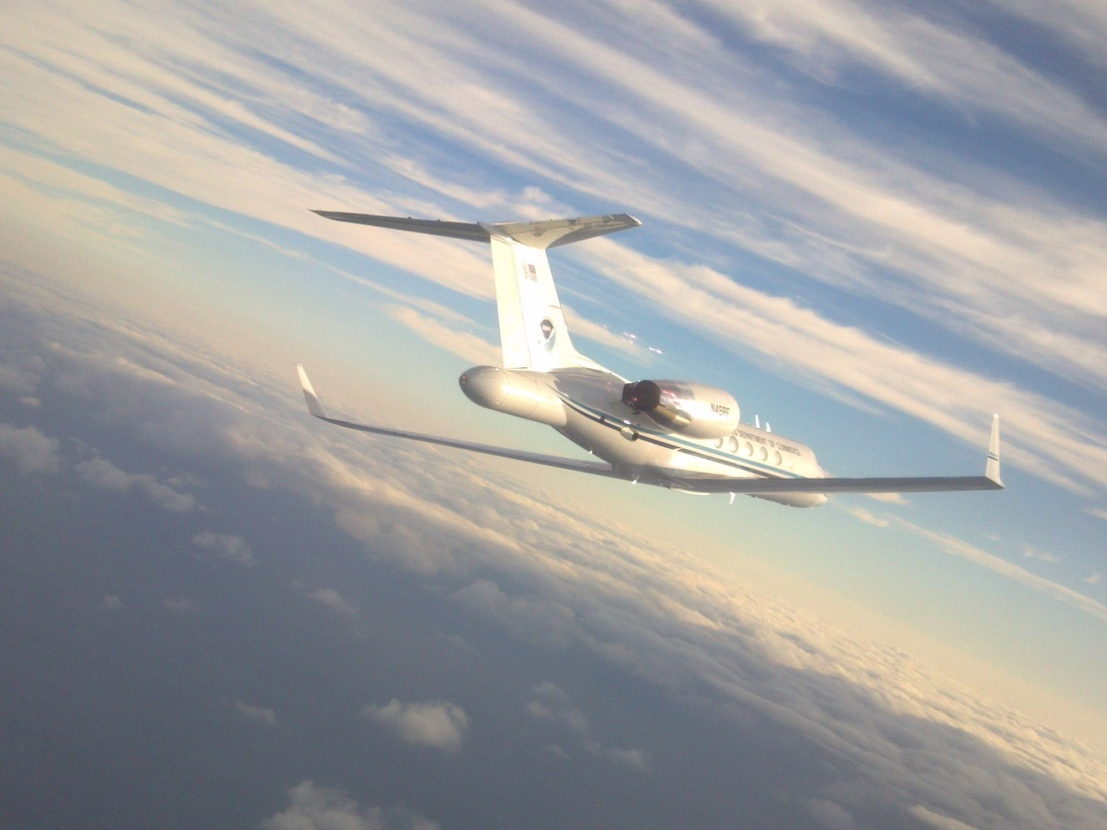
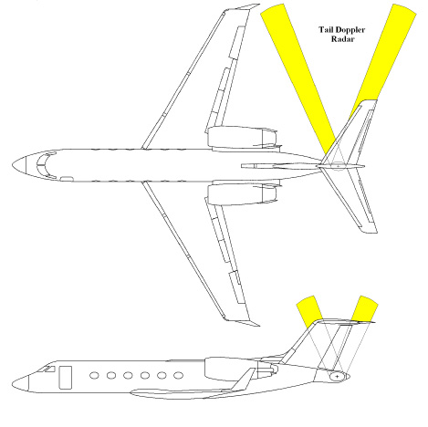
G-IV Radar
*Nose radar for weather detection and avoidance
*Tail Doppler Radar can detect precipitation and wind speed obtaining 3-D wind fields within the storm
Tail Doppler Radar

Slide 17
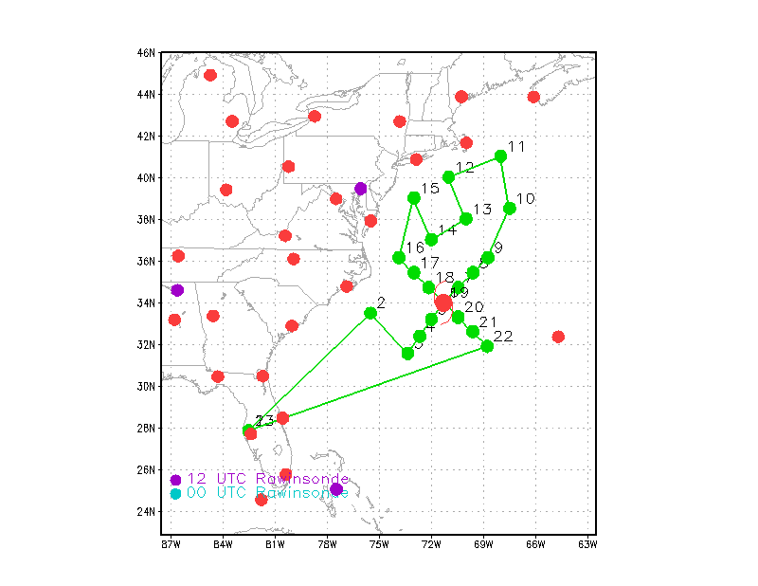
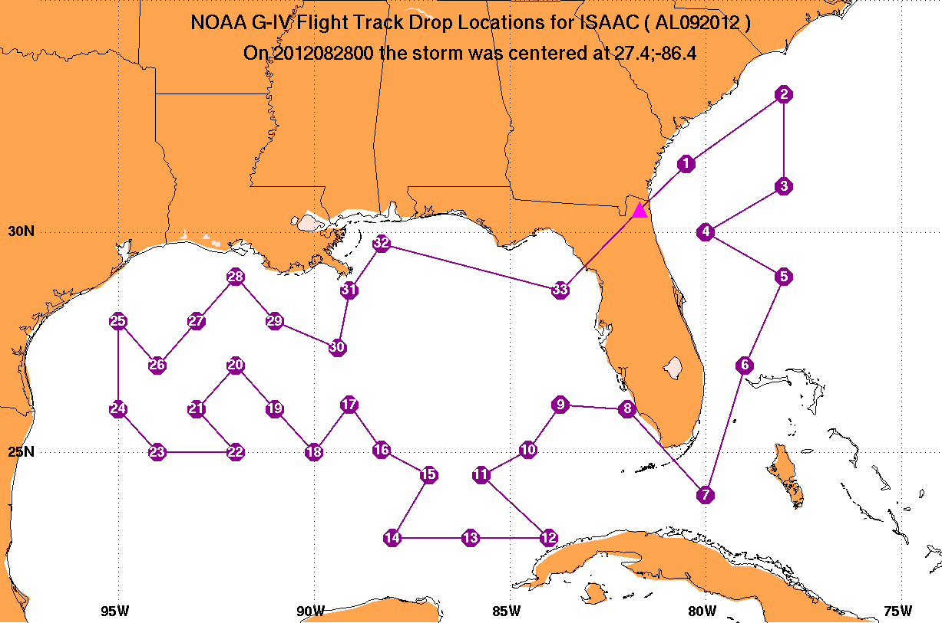
Examples of G-IV tracks
Research Flight
Surveillance Flight

Slide 18
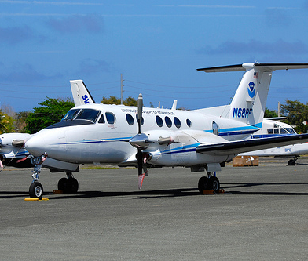
NOAA King Air 350
*Very advanced cameras to photograph and map the coastline and waterways

Slide 19
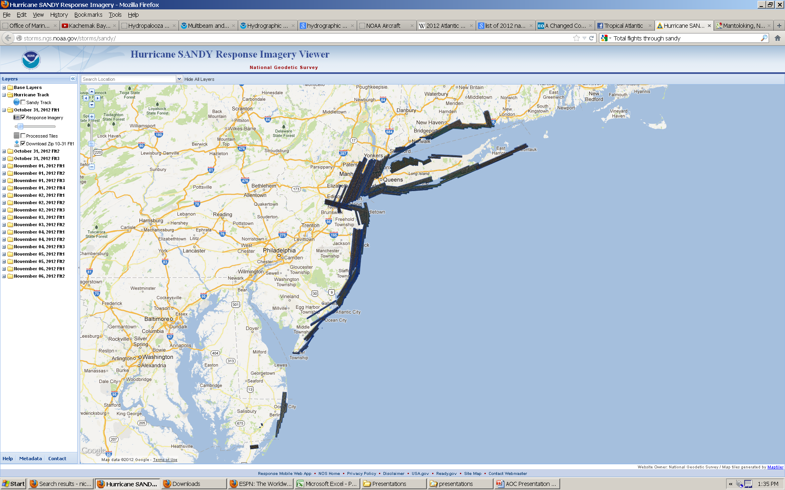
Hurricane Sandy Response Imagery

Slide 20
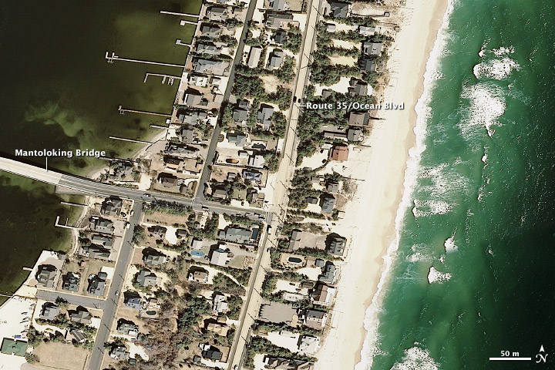
Mantoloking, New Jersey

Slide 21
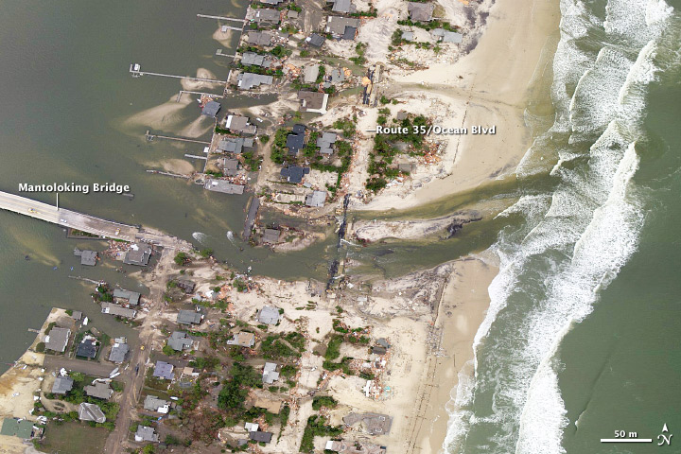
After Sandy….

Slide 22
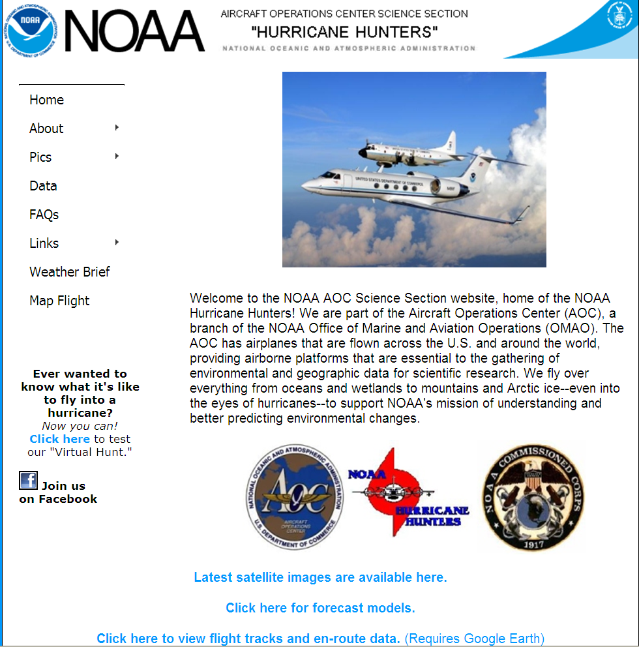
Web Page: http://flightscience.noaa.gov

Slide 23
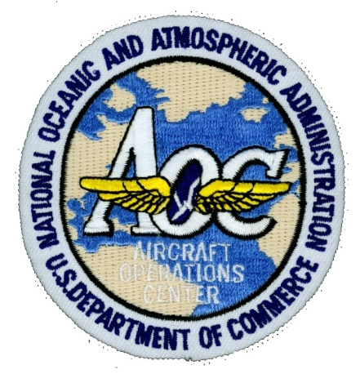

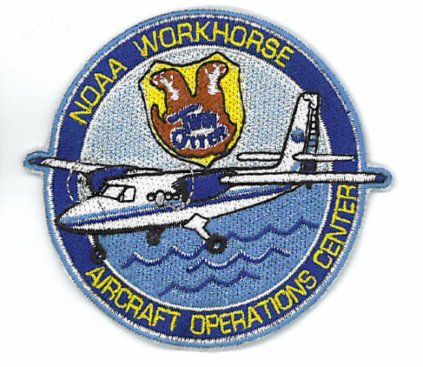
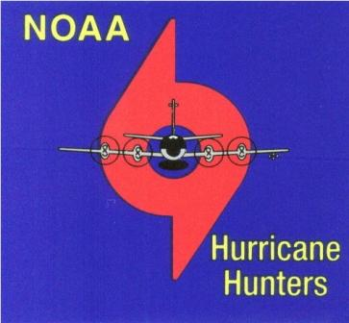
www.aoc.noaa.gov

