Slide 1
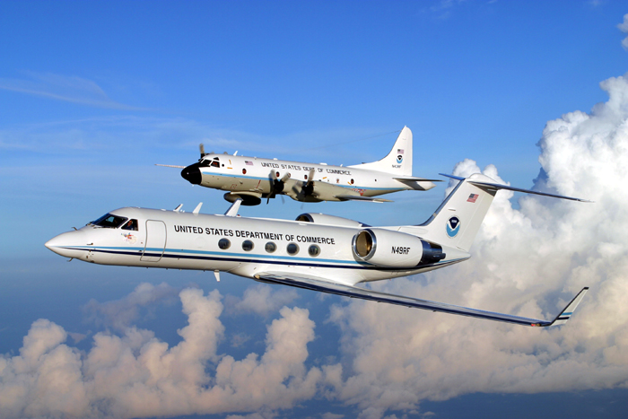


NOAA Aircraft Operations Center
Lakeland, Florida
Richard Henning, Flight Meteorologist
Welcome Korean Meteorological Administration
Notes:
67 extras- 8 per class

Slide 2
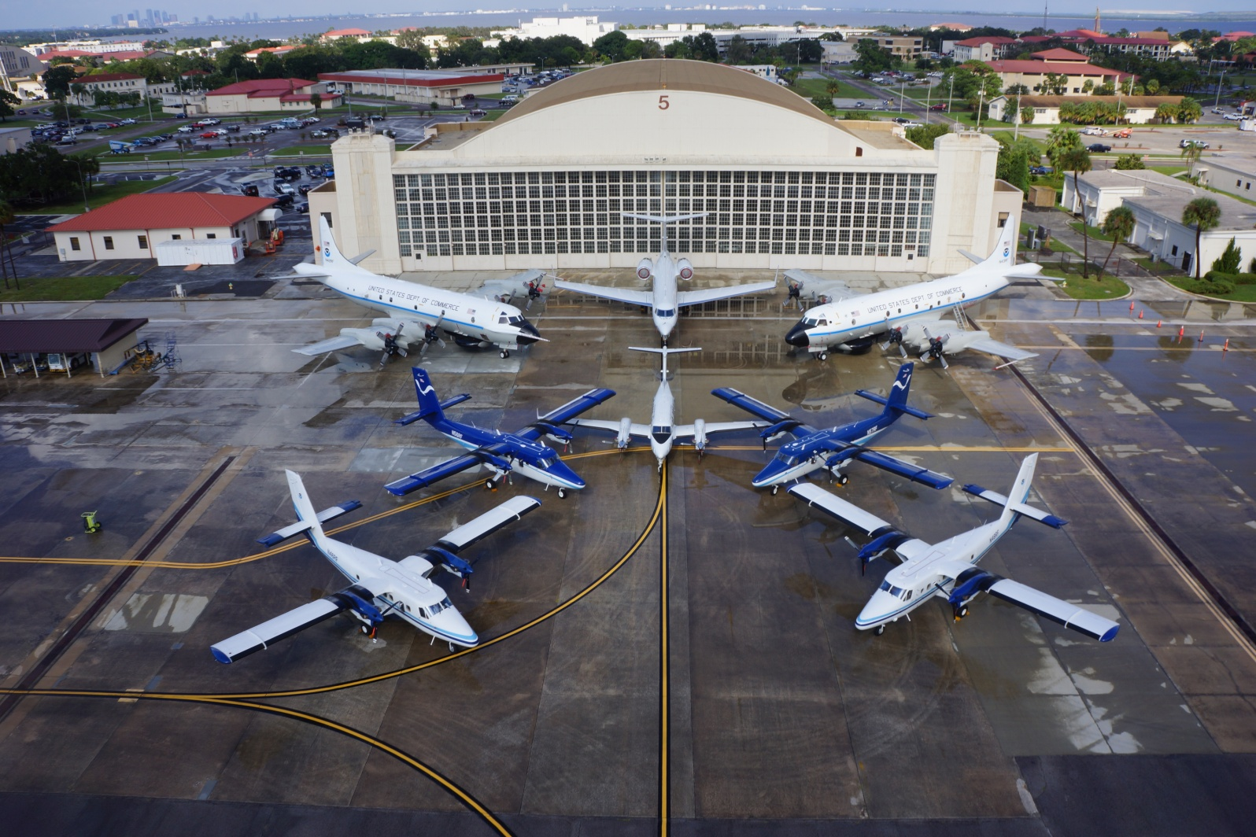
Where We Used to Work (our old home at MacDill AFB)

Slide 3
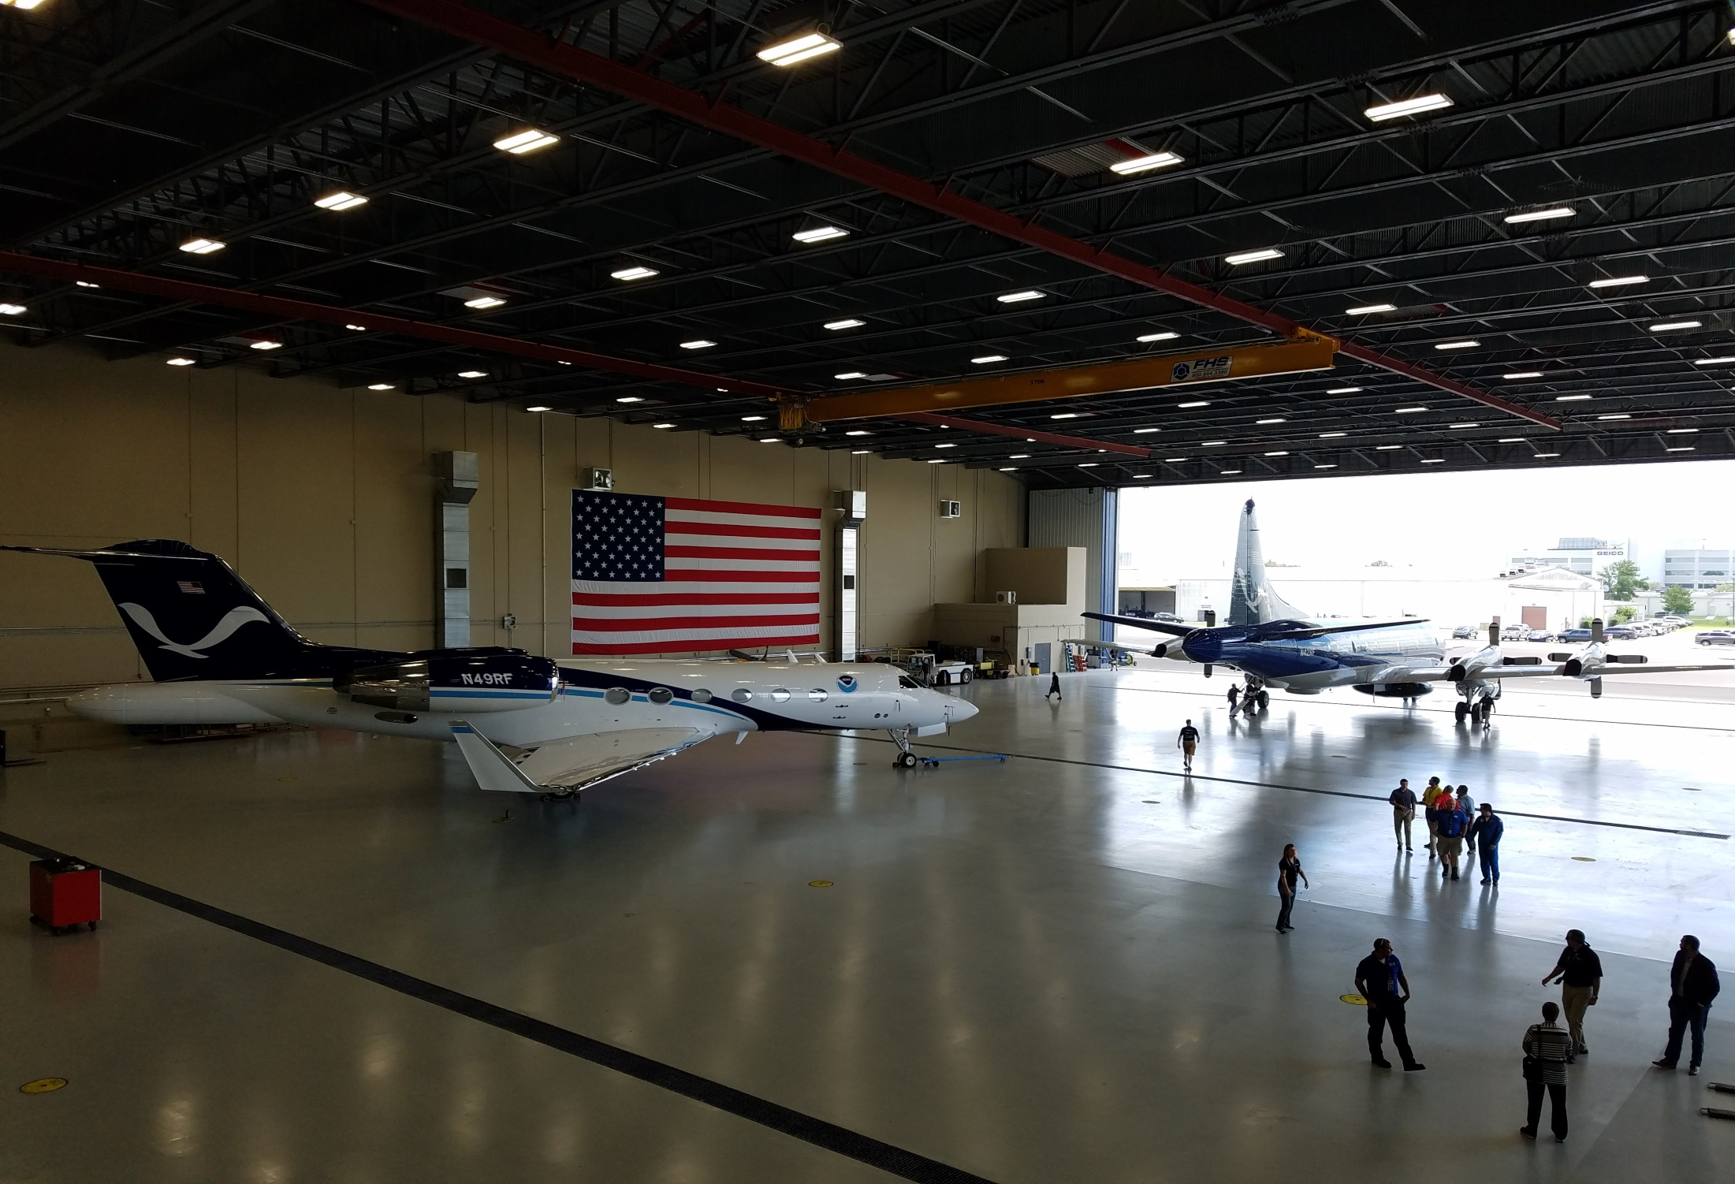
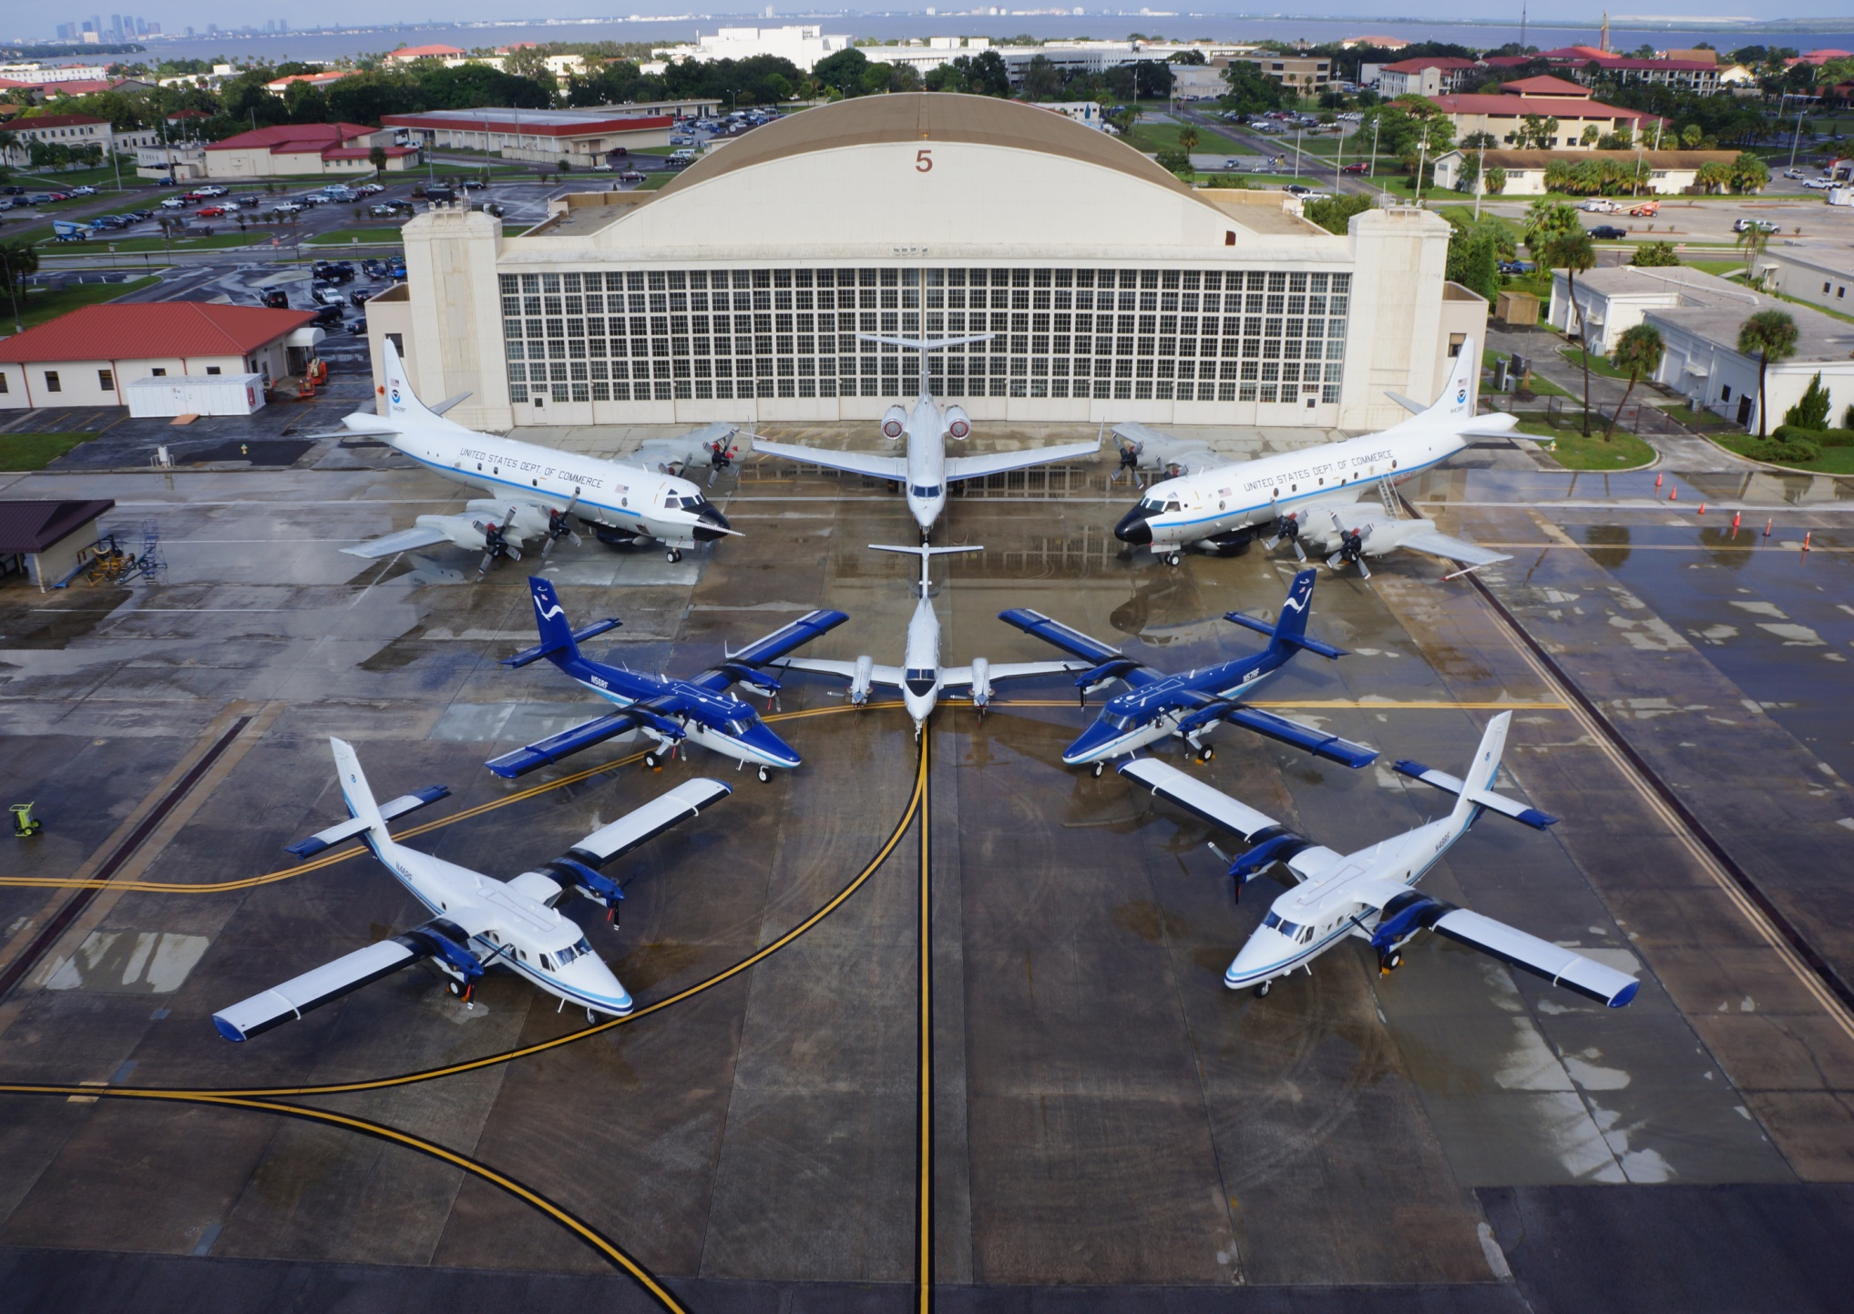
NOAA Aircraft Operations Center

Slide 4
Our new home at Linder Airport in Lakeland

Slide 5
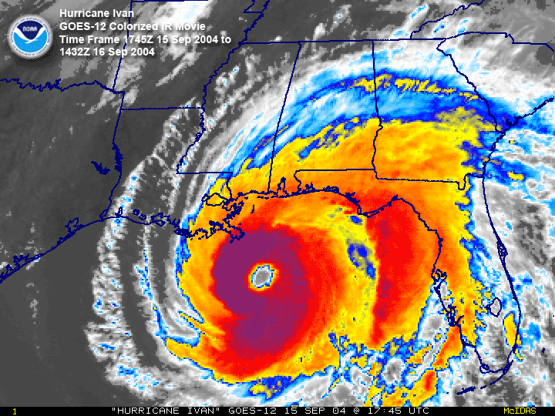

Slide 6
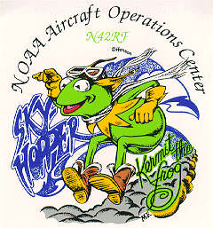
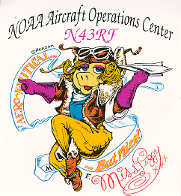
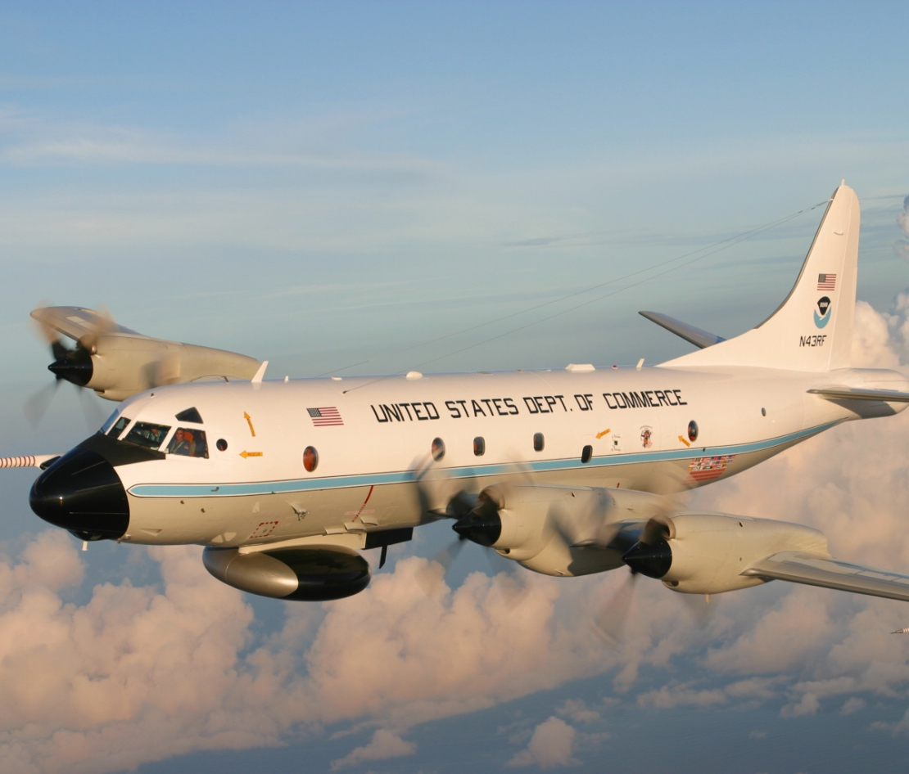
NOAA WP-3D Orion
“Kermit” & “Miss Piggy”
*Hurricane Hunters
*Flies inside the storm at 8,000ft – 12,000ft
*Crew of 18-20 includes pilots, engineers, navigators, and scientists
*Uses dropsondes and radar to gather data

Slide 7
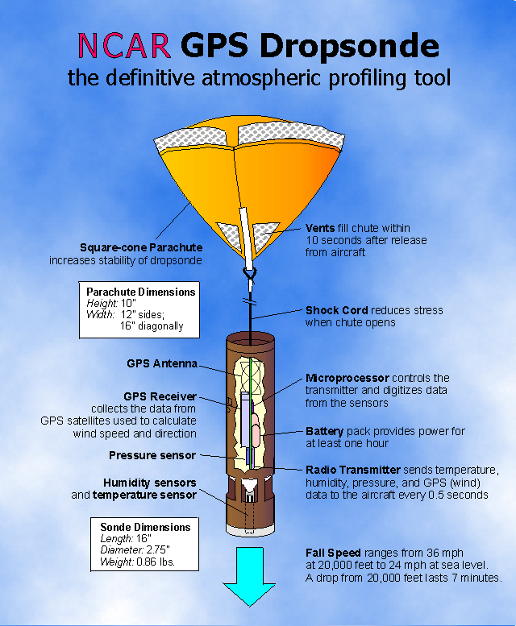
Dropwindsondes measure
  Air temperature
  Dewpoint
  Atmospheric pressure
  The GPS positioning is used to detect horizontal and vertical winds.
These data are measured and transmitted four times per second while the probe is in the air.

Slide 8
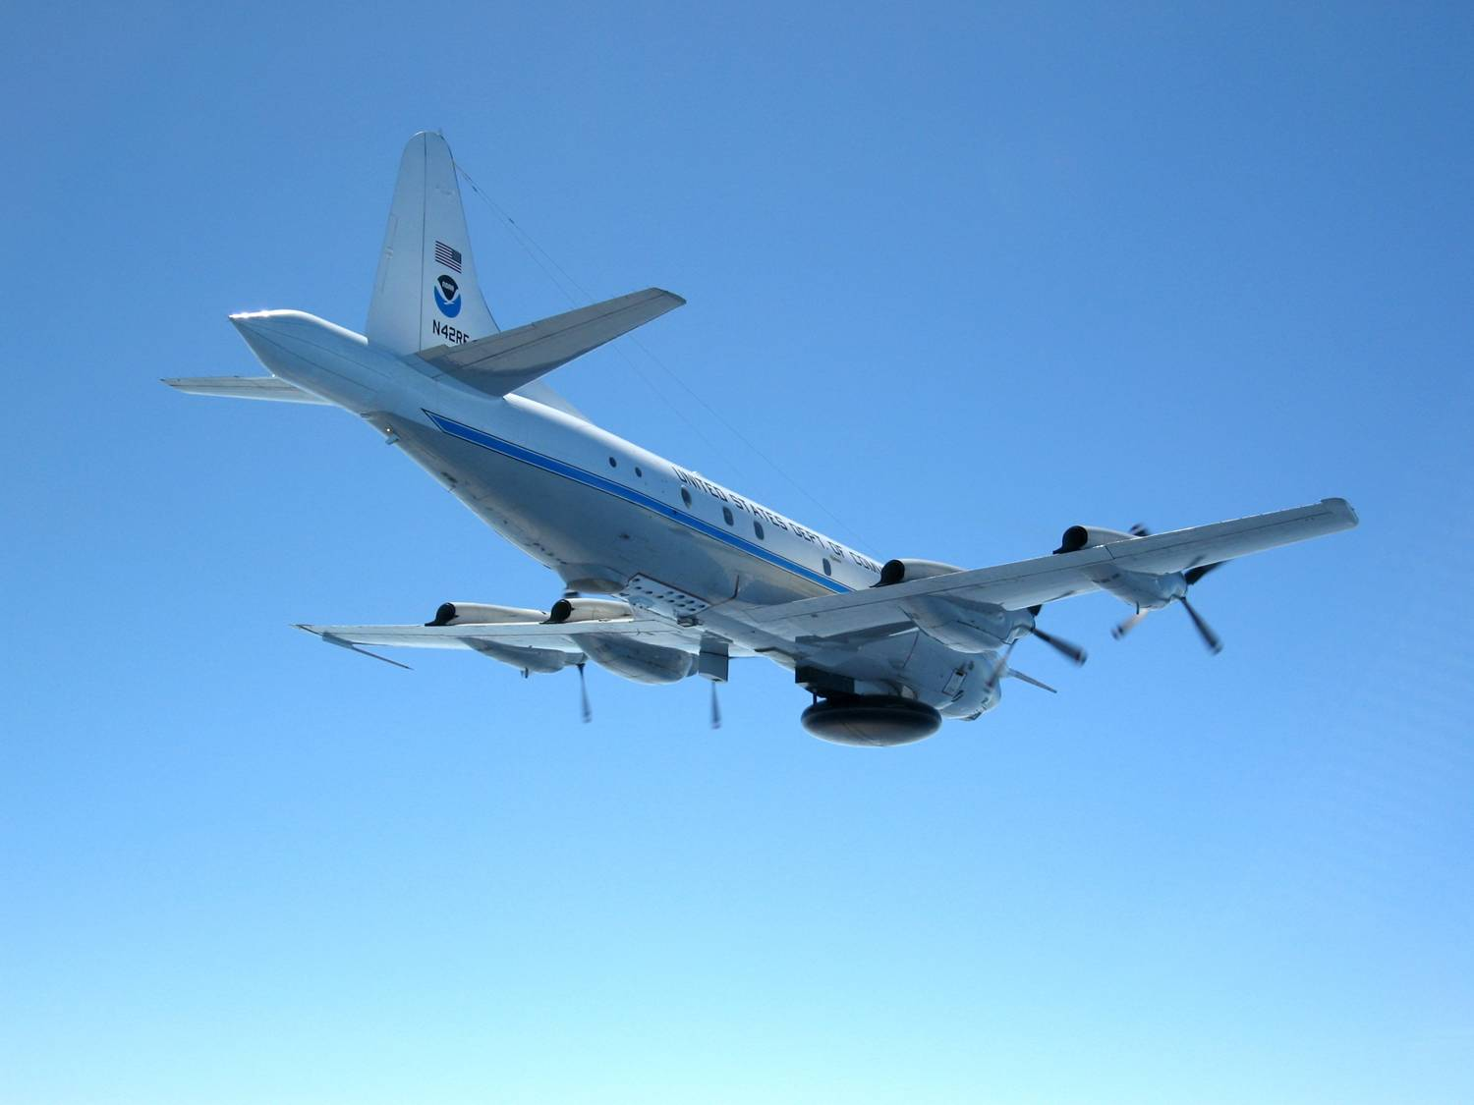
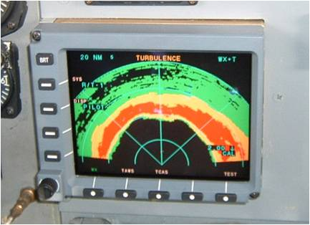
Three P-3 Radar Systems
Nose Radar
Tail Doppler Radar
Lower
Fuselage
MMR
Radar

Slide 9
P-3 TAIL DOPPLER RADAR DISPLAY

Slide 10
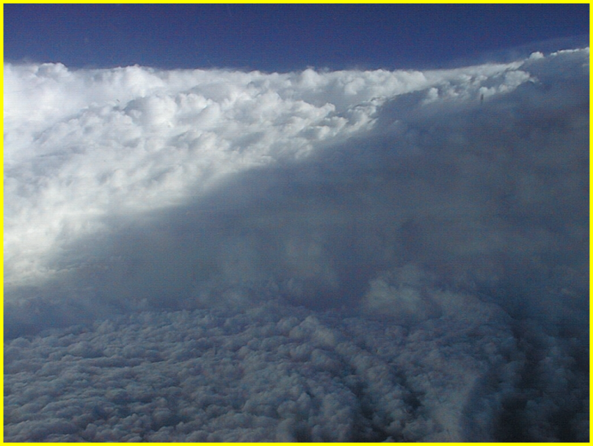
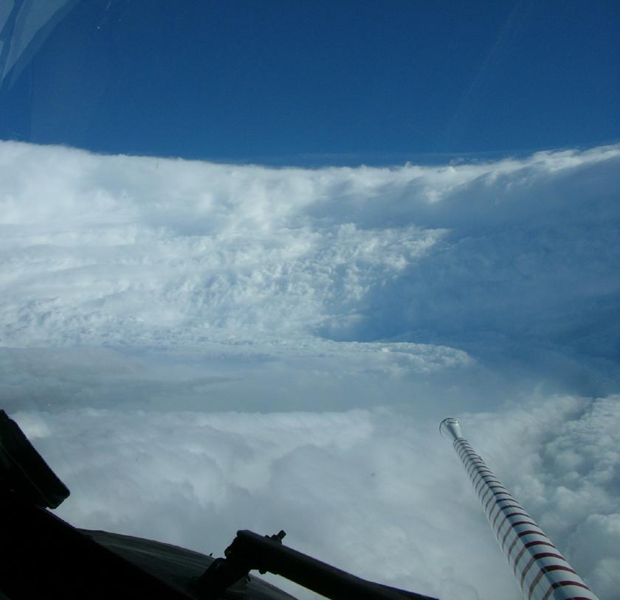
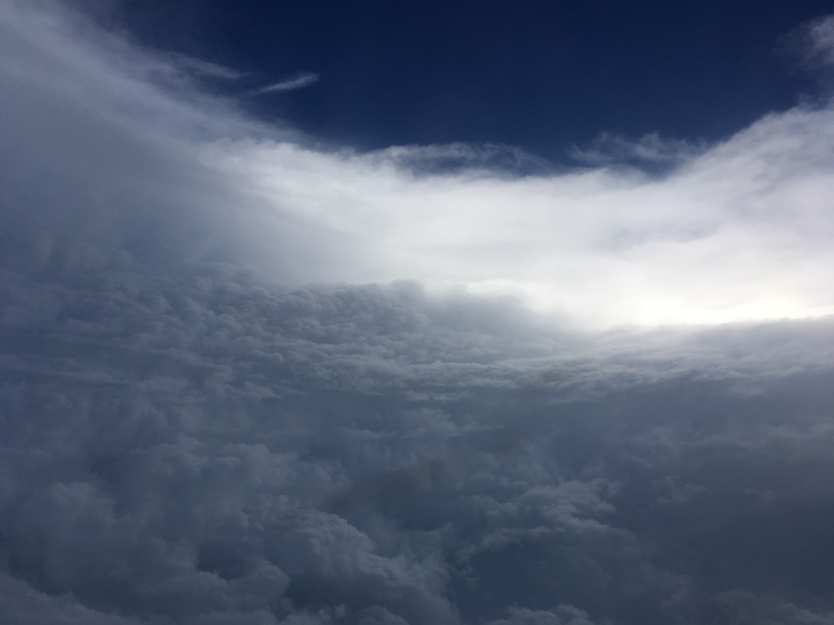
GEORGES 1998
The view from inside the eye a Hurricane
KATRINA 2005
LANE (PACIFIC 2018)

Slide 11


NOAA G-IV SP High Altitude Jet

Slide 13
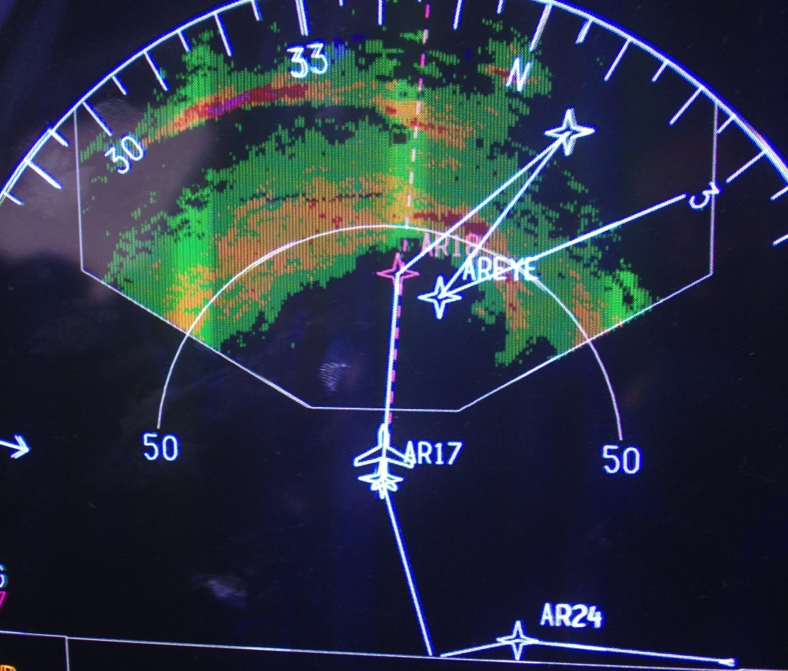
G-IV Radar
*Gonzo has 2 different radar systems on board
*Dropsondes help forecasters predict where the storm is going
*Highly advanced Tail Doppler Radar (TDR)

Slide 14
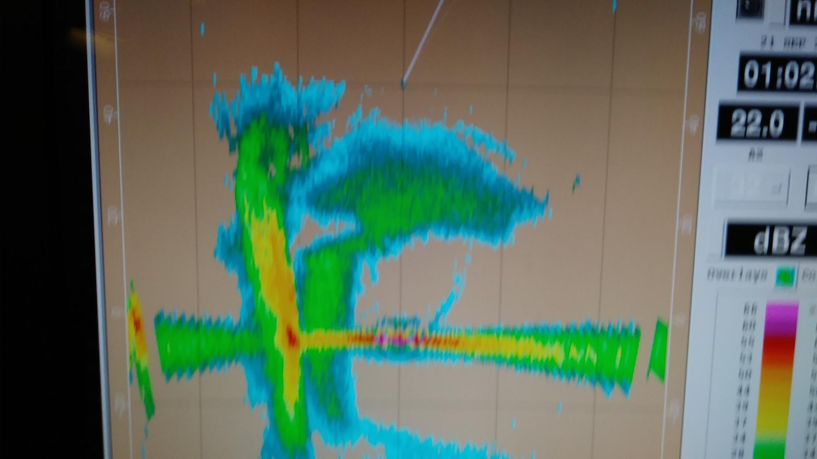
G-IV TAIL DOPPLER RADAR DISPLAY

Slide 15
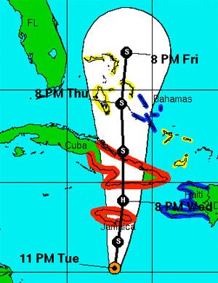
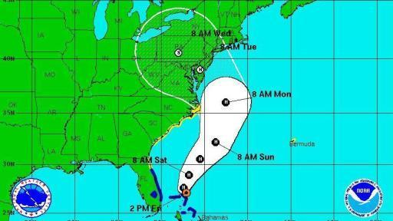
Better Hurricane Track Forecasts
Hurricane Sandy Forecast Track
from National Hurricane Center

Slide 16
IRMA MODEL TRACKS BEFORE FIRST G-IV MISSION

Slide 17
IRMA G-IV SYNOPTIC SURVEILLANCE PATTERN

Slide 19
IRMA MODEL TRACKS AFTER
MULTIPLE G-IV MISSIONS

Slide 20
DORIAN G-IV SYNOPTIC SURVEILLANCE PATTERN

Slide 21
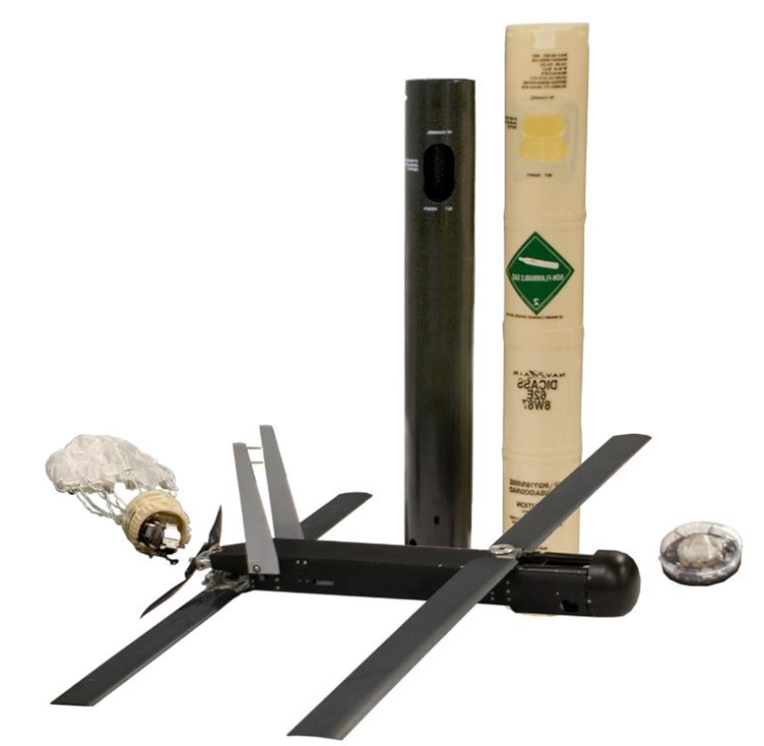

Coyote Unmanned Aerial System (UAS)
*Air-deployable expendable UAS , launched from the WP-3D Orion
*Able to provide low-altitude data inside the storm
*Up to 1-hour battery life

Slide 22


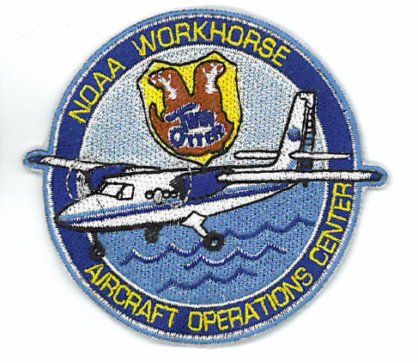

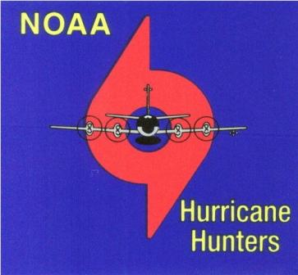
Thank you!

