Slide 1
CalWater 2015 G-IV Research Flight 11 22 Feb 2015 Subtropical AR Transect

Slide 2
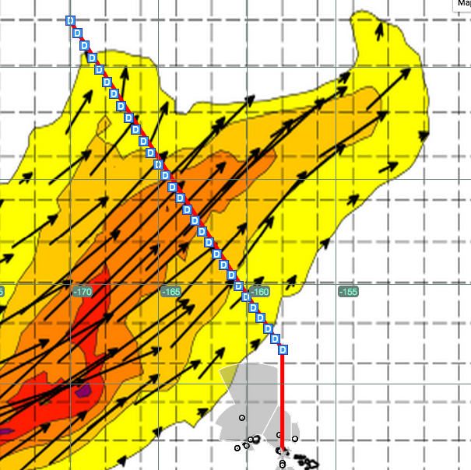
Research Flight 11
Subtropical AR Transect
SUN/22 Feb 2015
Take Off 1100 HT (21Z)
Duration ~7 h
Platform Scientist: Ryan Spackman
Observers: NOAA Corp Officers TBD
30 dropsondes at 40 nmi spacing along transect only in outbound direction
Flight Plan
WP | Lat | Lon
1 | 26°45’N | 158°00’W
2 | 42°00’ | 170°00’
3 | 26°45’ | 158°00’
NOTAM Box
Lat | Lon
25°00’N | 156°00’W
44°00’N | 168°00’W
44°00’N | 178°00’W
21°00’N | 164°00’W

Slide 3
Dropsonde | Lat | Lon
1 | 26° 45' | 158° 00'
2 | 27° 17' | 158° 25'
3 | 27° 48' | 158° 50'
4 | 28° 20' | 159° 14'
5 | 28° 51' | 159° 39'
6 | 29° 23' | 160° 04'
7 | 29° 54' | 160° 29'
8 | 30° 26' | 160° 54'
9 | 30° 57' | 161° 19'
10 | 31° 29' | 161° 43'
11 | 32° 01' | 162° 08'
12 | 32° 32' | 162° 33'
13 | 33° 04' | 162° 58'
14 | 33° 35' | 163° 23'
15 | 34° 07' | 163° 48'
16 | 34° 38' | 164° 12'
17 | 35° 10' | 164° 37'
18 | 35° 41' | 165° 02'
Dropsonde | Lat | Lon
19 | 36° 13' | 165° 27'
20 | 36° 44' | 165° 52'
21 | 37° 16' | 166° 17'
22 | 37° 48' | 166° 41'
23 | 38° 19' | 167° 06'
24 | 38° 51' | 167° 31'
25 | 39° 22' | 167° 56'
26 | 39° 54' | 168° 21'
27 | 40° 25' | 168° 46'
28 | 40° 57' | 169° 10'
29 | 41° 28' | 169° 35'
30 | 42° 00' | 170° 00'

