Slide 1
CalWater 2015 G-IV Research Flight 9 19 Feb 2015 Subtropical IVT Transect

Slide 2
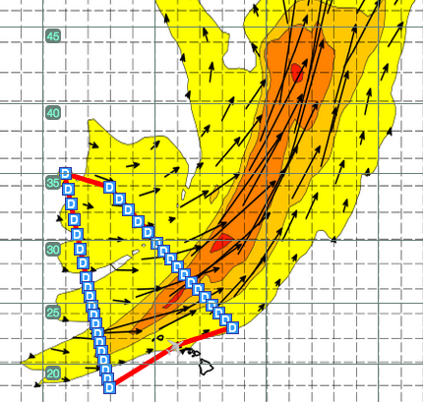
Research Flight 9
Subtropical IVT Transect
THU/19 Feb 2015 Take Off 1400 HT (Fri 00Z)
Duration ~7 h
Platform Scientist: Ryan Spackman (on ground)
Observer: John Helly is TBD (observer)
37 dropsondes mostly at 68 nmi spacing with higher-resolution drops at 49 nmi spacing near the AR core on both long transects (between WP 1 & 2 and WP 3 & 4)
Flight Plan
NOTAM Box
WP | Lat | Lon
1 | 23°00’N | 153°00’W
2 | 34°00’N | 164°00’
3 | 35°00’ | 168°00’
4 | 18°00’ | 164°00’
Lat | Lon
21°00’N | 151°00’W
36°00’N | 162°00’W
37°00’N | 170°00’W
16°00’N | 166°00’W
Init 6Z Thu 2/19/15
Valid 3Z Fri 2/20/15
Flight Notes
Perform flight pattern in counter-clockwise direction
Exact coordinates for dropsonde release will be provided in the the AM on the flight day

Slide 3
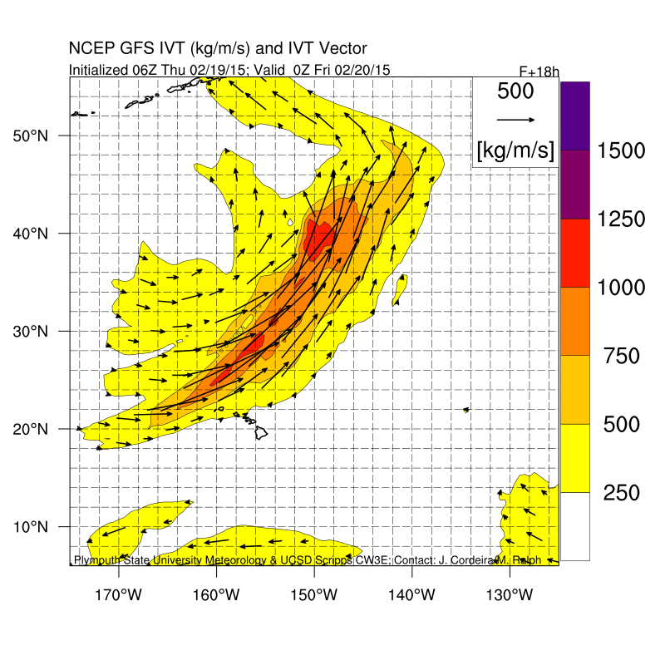
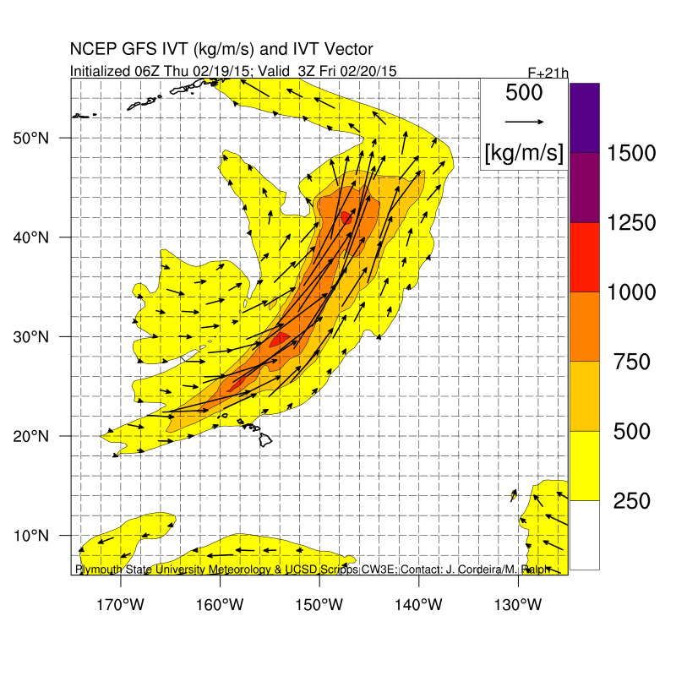
C
B
C
B
A
A
D
D

Slide 4
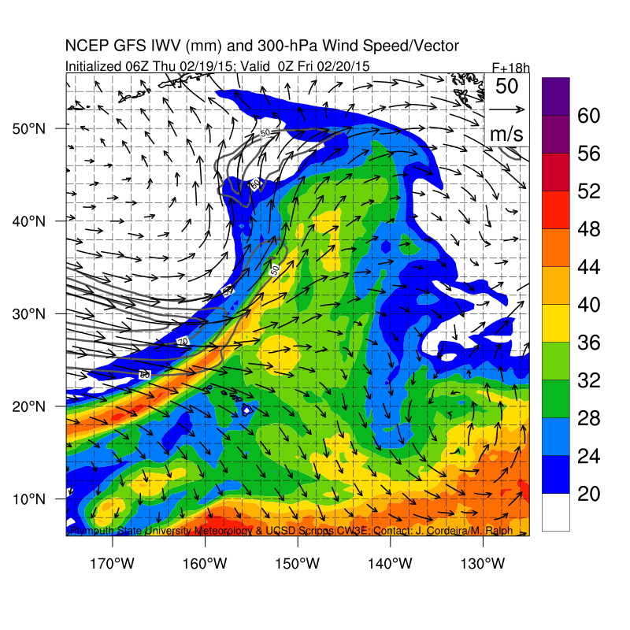
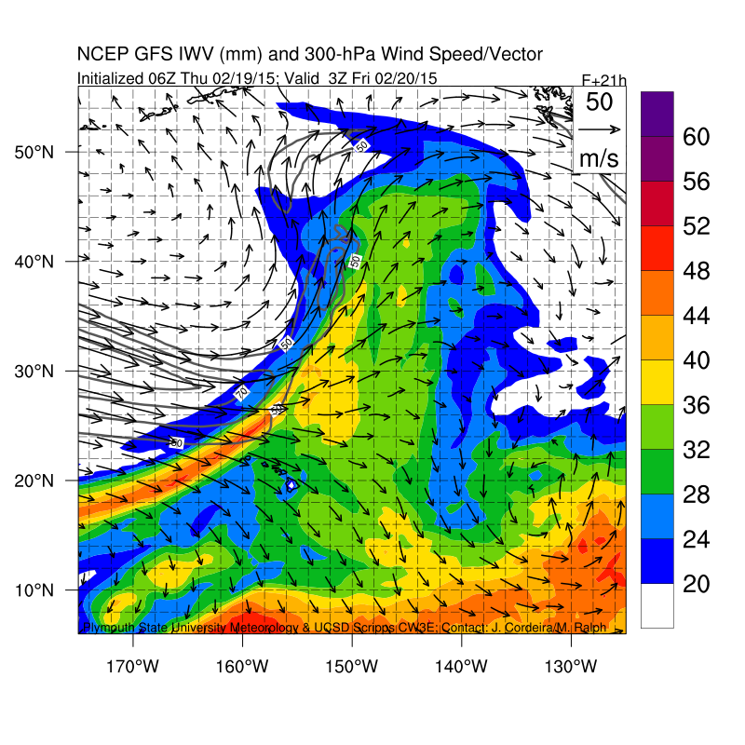
C
B
C
B
A
A
D
D

Slide 5
Dropsonde | Lat | Lon
1 | 23° | 153°
2 | 23° 37' | 153° 37'
3 | 24° 14' | 154° 14'
4 | 24° 51' | 154° 51'
5 | 25° 28' | 155° 28'
6 | 26° 5' | 156° 5'
7 | 26° 42' | 156° 42'
8 | 27° 18' | 157° 18'
9 | 27° 55' | 157° 55'
10 | 28° 32' | 158° 32'
11 | 29° 9' | 159° 9'
12 | 29° 46' | 159° 46'
13 | 30° 37' | 160° 37'
14 | 31° 28' | 161° 28'
15 | 32° 18' | 162° 18'
16 | 33° 9' | 163° 9'
17 | 34° | 164°
18 | 35° | 168°
Dropsonde | Lat | Lon
19 | 33° 52' | 167° 44'
20 | 32° 44' | 167° 28'
21 | 31° 36' | 167° 12'
22 | 30° 28' | 166° 56'
23 | 29° 20' | 166° 40'
24 | 28° 12' | 166° 24'
25 | 27° 4' | 166° 8'
26 | 26° 19' | 165° 57'
27 | 25° 33' | 165° 47'
28 | 24° 48' | 165° 36'
29 | 24° 3' | 165° 25'
30 | 23° 17' | 165° 15'
31 | 22° 32' | 165° 4'
32 | 21° 47' | 164° 53'
33 | 21° 1' | 164° 43'
34 | 20° 16' | 164° 32'
35 | 19° 31' | 164° 21'
36 | 18° 45' | 164° 11'
37 | 18° | 164°

