Slide 1
CalWater 2015 G-IV Research Flight 10 19 Feb 2015 Subtropical IVT Transect II

Slide 2
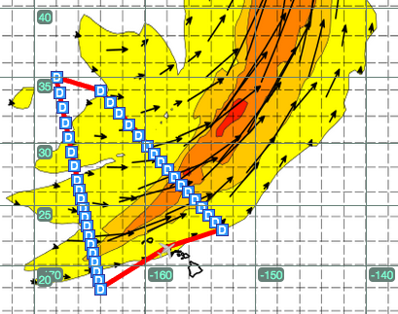
Research Flight 10
Subtropical IVT Transect II
THU/19 Feb 2015 Take Off 1400 HT (Fri 00Z)
Duration ~7 h
Platform Scientist: Ryan Spackman
Onboard Scientist: TBD (possible local observers)
37 dropsondes mostly at 68 nmi spacing with higher-resolution drops at 49 nmi spacing near the AR core on both long transects (between WP 1 & 2 and WP 3 & 4)
Flight Plan
NOTAM Box
WP | Lat | Lon
1 | 23°00’N | 153°00’W
2 | 34°00’N | 164°00’
3 | 35°00’ | 168°00’
4 | 18°00’ | 164°00’
Lat | Lon
21°00’N | 151°00’W
36°00’N | 162°00’W
37°00’N | 170°00’W
16°00’N | 166°00’W
Init 12Z Wed 2/18/15
Valid 3Z Fri 2/20/15
Flight Notes
Perform flight pattern in counter-clockwise direction
Exact coordinates for dropsonde release will be provided in the the AM on the flight day

