Slide 1
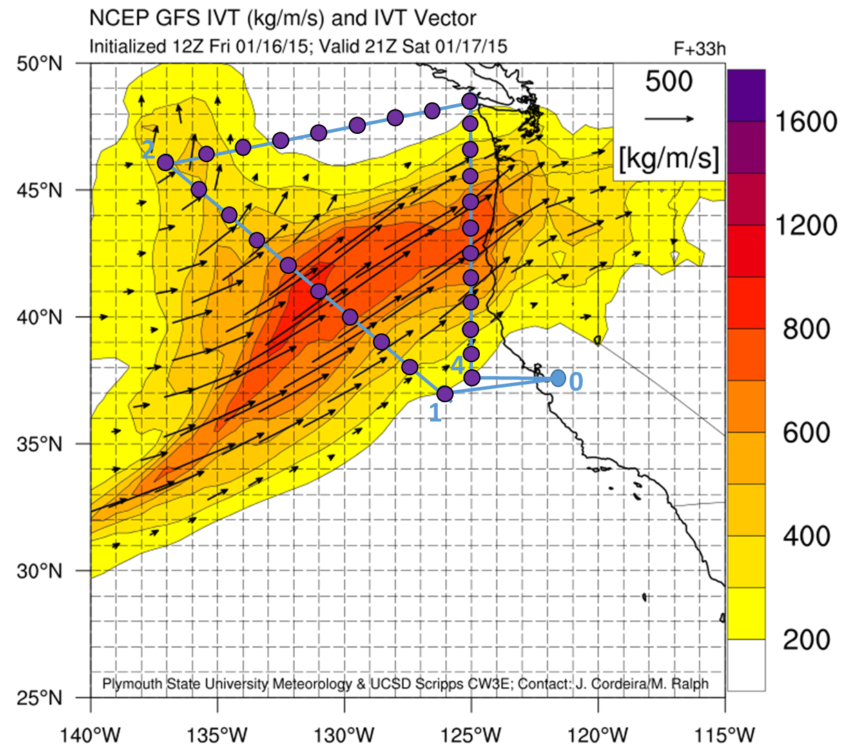
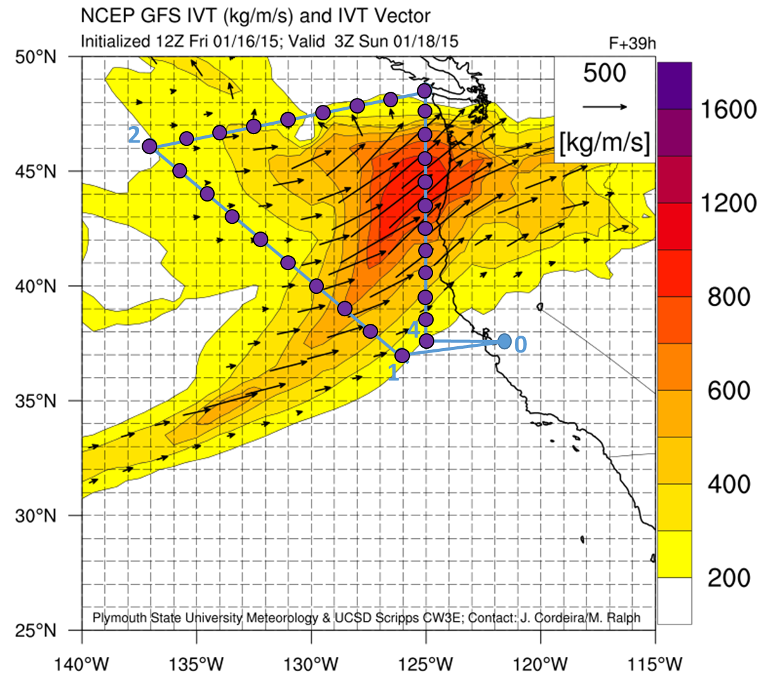
G-IV DRAFT Flight Plan Take off 21Z Sat. 1/17 (1 pm LT Sat.), landing approximately 03Z Sun. 1/18 (7 pm LT Sat.)
Leg 0-1 no drops; Leg 1-2 every 1.0 deg. Lat. 10 drops; Leg 2-3 every 1 deg. 30 min. Lon. 7 drops; Leg 3-4 every 1.0 deg. Lat. 12 drops. Total drops for flight = 29.
Janet Intrieri
Platform Scientist
Coordinates for NOTAM Box
Near WP 1: 34.0 deg. N, 126.0 deg. W
Near WP 2: 48.0 deg. N, 142.0 deg. W
Near WP 3: 51.0 deg. N, 124.0 deg. W
Near WP 4: 35.0 deg. N, 124.0 deg. W
Flight Track Way-Points
WP 1: 37.0 deg. N, 126.0 deg. W
WP 2: 46.0 deg. N 137.0 deg. W
WP 3: 48 deg. 30 min. N, 125.0 deg. W
WP 4: 37 deg. 30 min. N, 125.0 deg. W

Slide 2
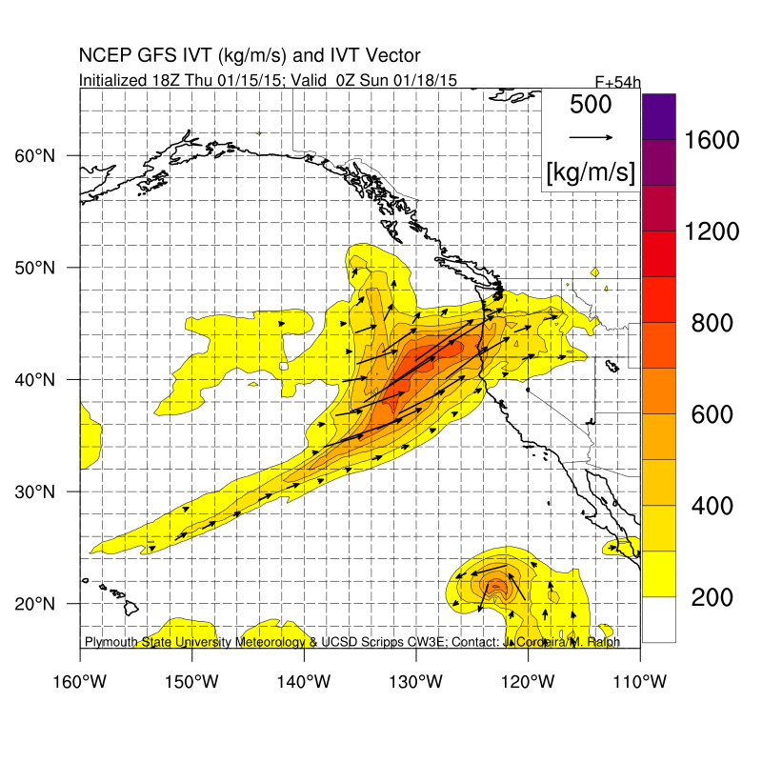
Blue = flight
Black = NOTAM

