Slide 1
NOAA9 23WSC TRACK55 flying backwards
20120222N1

Slide 2
TRACK55

Slide 4
Current Station Conditions
PHJR 221753Z 06005KT 10SM CLR 23/16 A3011 RMK AO2 SLP204 T02280161 10228 20211 53013
PHJR 221736Z 2218/2318 07005KT P6SM FEW030
FM221900 11011G18KT P6SM FEW035 SCT050
FM230500 07004KT P6SM FEW030
PHNL 221753Z 05011KT 10SM FEW027 SCT038 SCT044 23/17 A3010 RMK AO2 SLP193 VCSH SE T02330167 10233 20217 53013
PHNL 221736Z 2218/2324 07009KT P6SM FEW025 SCT050
FM222000 08013G20KT P6SM FEW030 SCT050
FM230500 06008KT P6SM FEW030 SCT050
FM232000 06012G20KT P6SM FEW030 SCT050
Notes:
Takeoff –

Slide 5
Surface Analysis

Slide 6
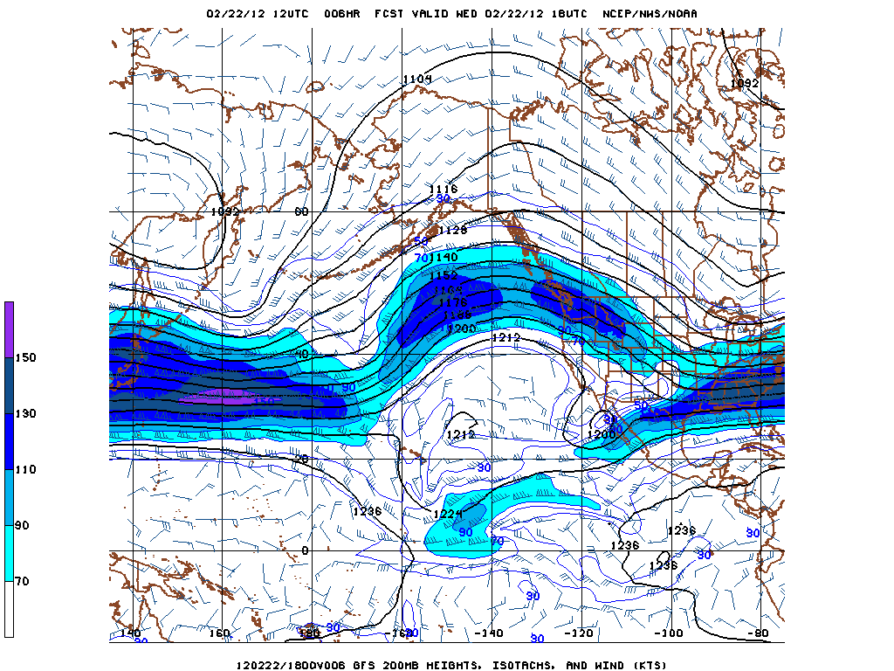
18Z 200mb winds (approx FL390)
Notes:
Jet max erodes over the period of the mission. Do not expect moderate to severe turbulance, due to weak jet max.

Slide 7
IR Satellite
Notes:
Note cold front position. Possible convection to the west. Should not affect flight.

Slide 8
Turbulence and Jet Position
Notes:
Below flight level

Slide 9
Volcanic Ash Reports
Negative

Slide 10
Approach back at PHJR

Slide 11
Mission Items
17 Drops

