Slide 1
NOAA9 21WSC TRACK54
20120217N1

Slide 2
TRACK54

Slide 4
Current Station Conditions
PHJR 171753Z 00000KT 10SM CLR 22/17 A3023 RMK AO2 SLP241 60000 T02170172 10228 20200 53017
PHJR 171732Z 1718/1818 07004KT P6SM FEW050
FM172000 07010G18KT P6SM FEW035 SCT050
FM180300 07005KT P6SM FEW035 SCT050
PHNL 171753Z 06011KT 10SM FEW027 SCT033 SCT040 23/17 A3021 RMK AO2 SLP230 VCSH OMTNS SE 60000 T02280167 10228 20217 53018 $
PHNL 171732Z 1718/1824 06012KT P6SM FEW030 SCT050
FM172000 06015G22KT P6SM FEW030 SCT050
FM180500 06012KT P6SM FEW030 SCT050
FM182000 06017G25KT P6SM FEW030 SCT050
Notes:
Takeoff –

Slide 5
Surface Analysis

Slide 6
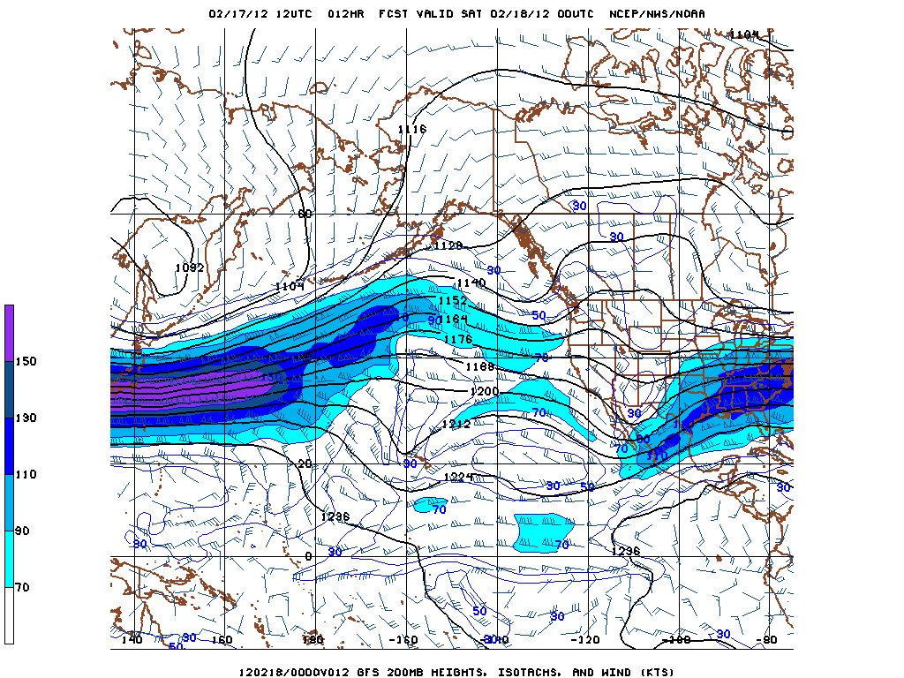
00Z 200mb winds (approx FL390)
Notes:
Jet max erodes over the period of the mission. Do not expect moderate to severe turbulance, due to weak jet max.

Slide 7
IR Satellite
Notes:
Note cold front position. Possible convection to the west. Should not affect flight.

Slide 8
Turbulence and Jet Position
Notes:
Below flight level

Slide 9
Volcanic Ash Reports
Negative

Slide 10
Approach back at PHJR
Gusty Trade winds throughout today. E to NE @ 15kts gusting to 20kts.

Slide 11
Mission Items
16 Drops
Weather Channel Interview at 0505 Eastern (0005 Local)

