Slide 1
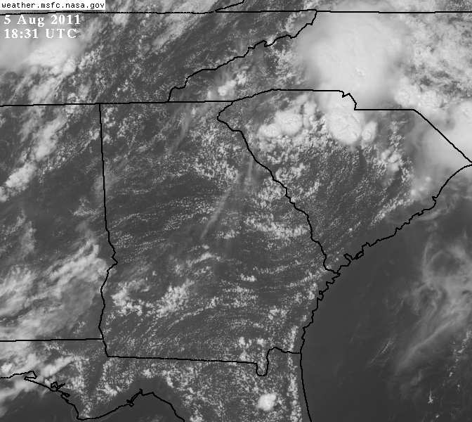
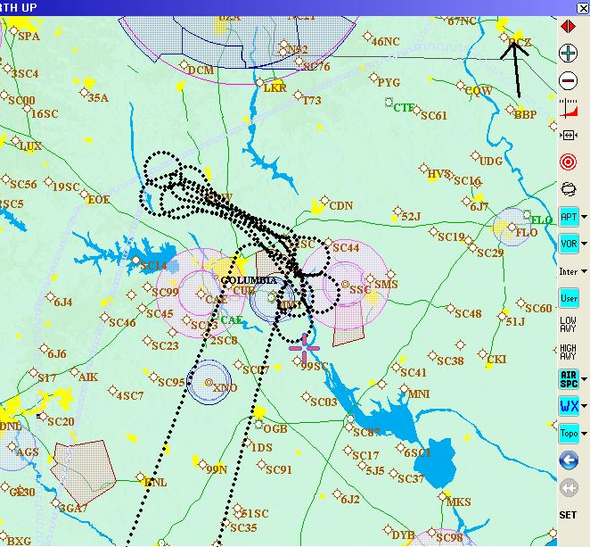
G-IV TDR OSAT #2
Reflectivity and Velocity 20110805N1

Slide 2
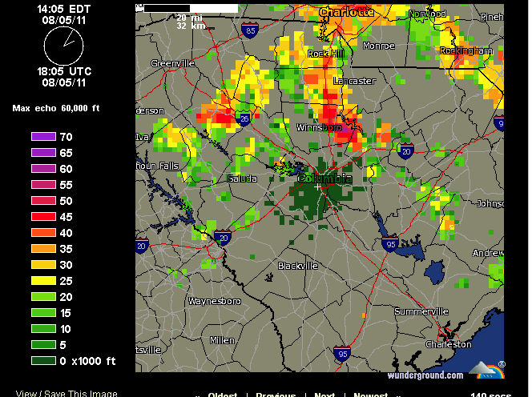

Slide 3
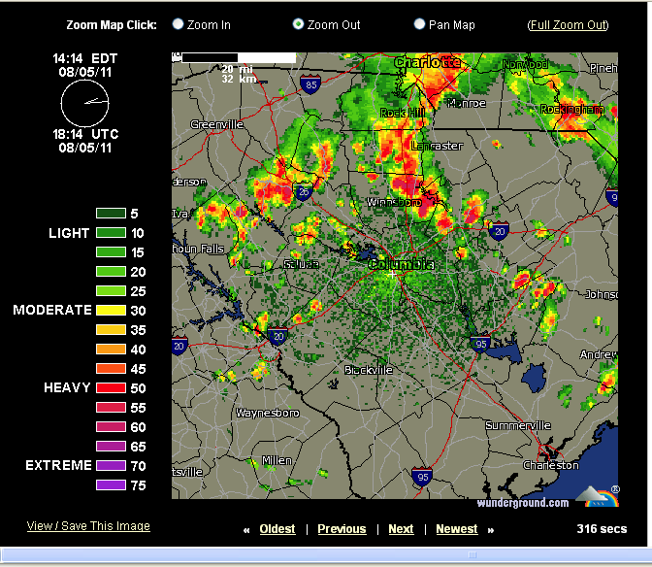

Slide 4
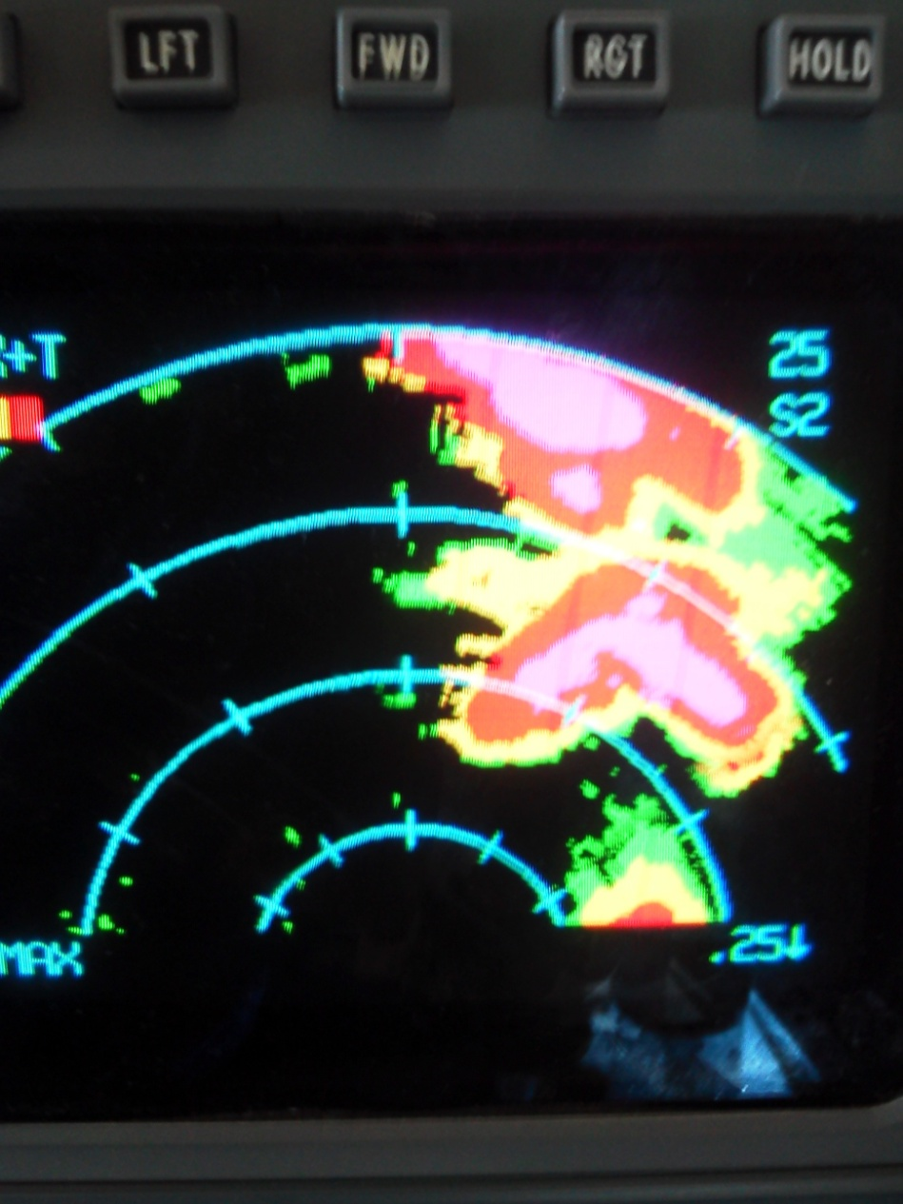
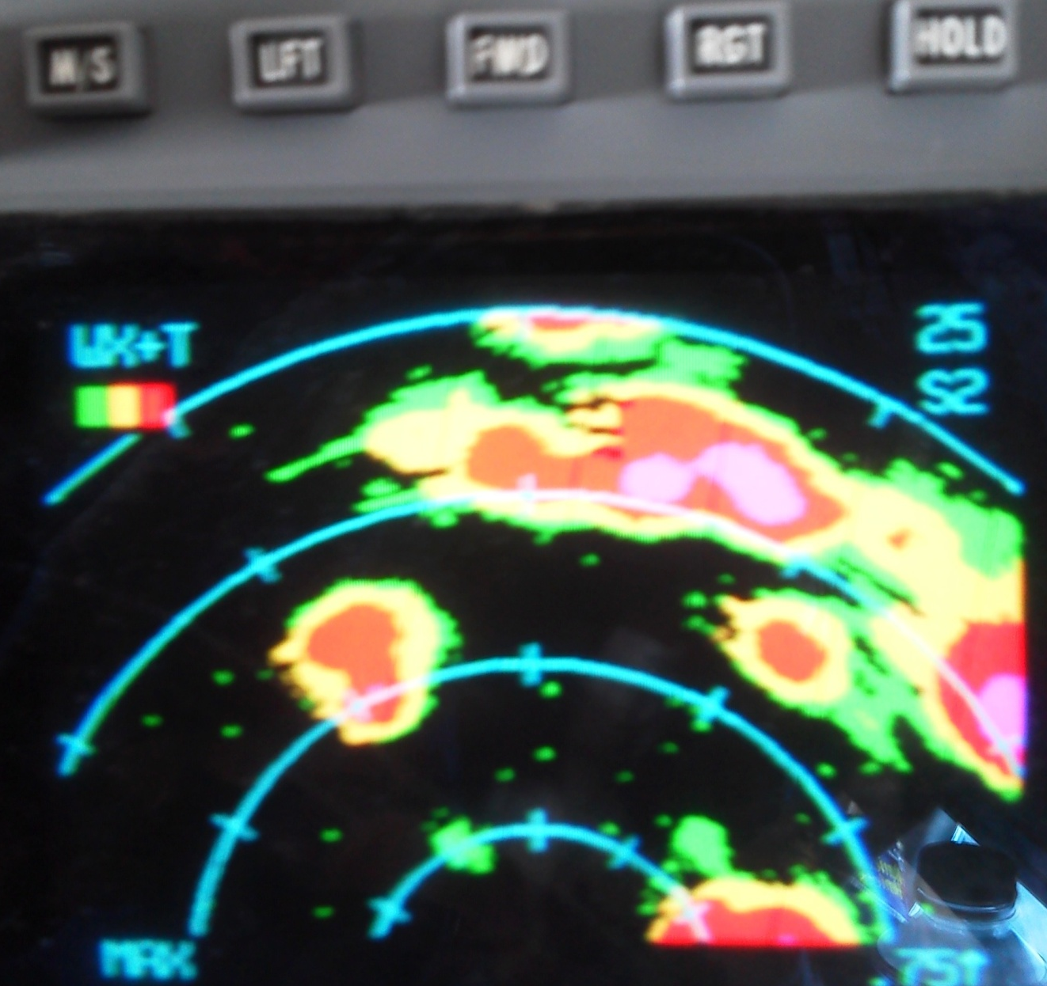
Nose Radar Shots ~ 1830Z
Keeping targets within 20NM for TDR painting

Slide 5


Slide 6
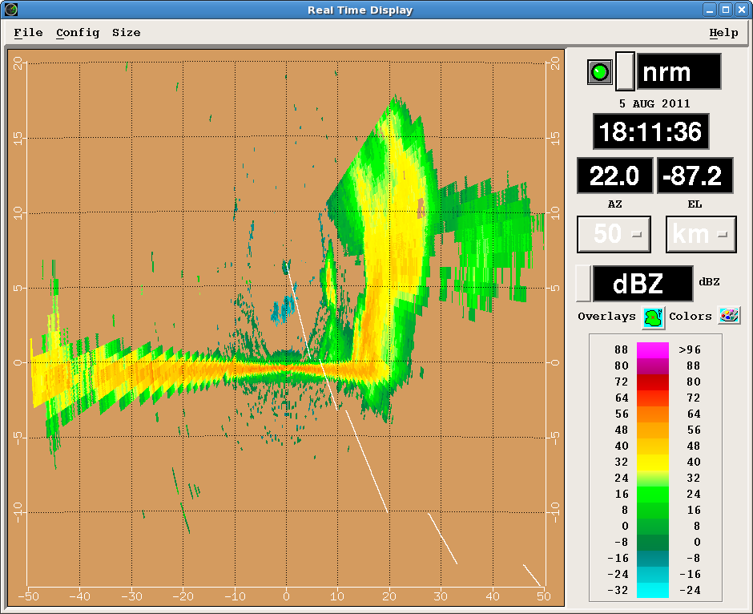
Reflectivity. Tops to ~ 55k.
Note dBZ color Scale. Max ~60dBZ

Slide 7
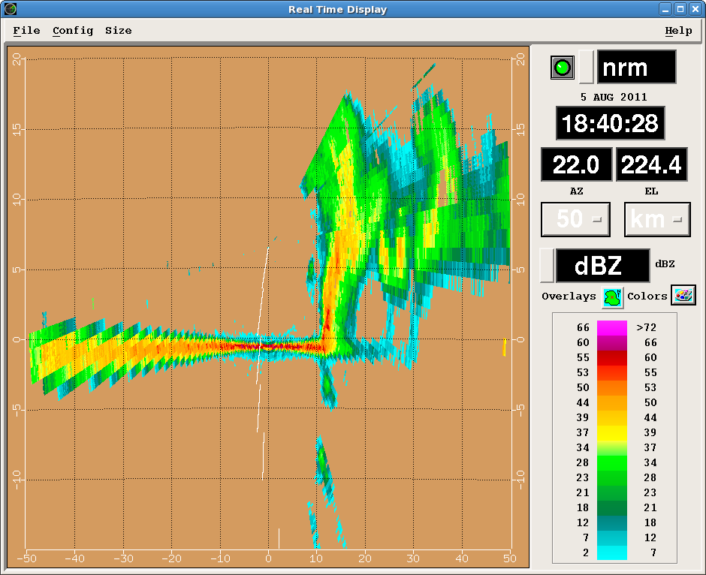
Note dBZ color scale change
Still 55-60dBZ recorded

Slide 8
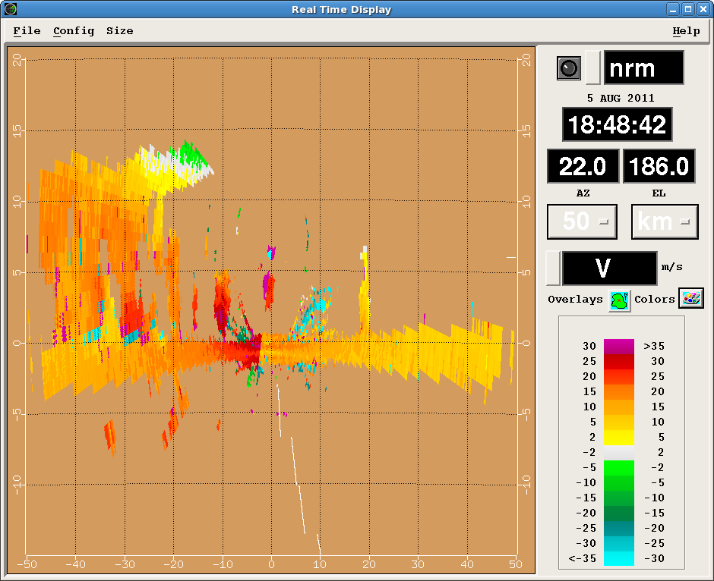
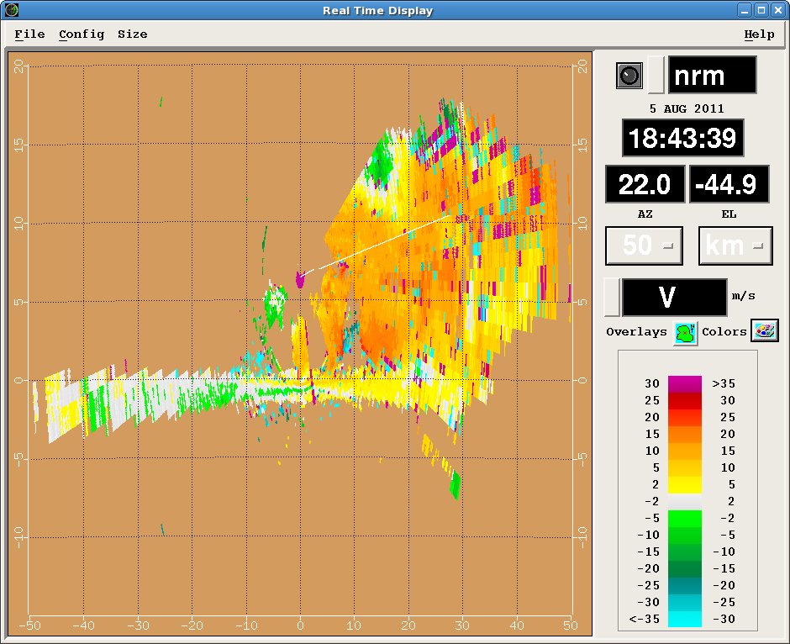
Velocity

