Slide 2
Out-of-CAL
Blue out-of-CAL is an under-lay of information indicating regions behind other regions of cumulative intervening attenuation significant enough to possibly compromise indication of +47 dBz, 3 nmi diameter thunderstorm
Out-of-CAL uses an estimate of intervening attenuation based on measured rain rate and possible immeasurable rain rate (signal return below noise)
Displayed rain returns are based solely on measured rain intensities.
Northrop changed the way the radar calculates intervening attenuation.
If the radar detects a cell beyond the out-of cal depiction it will show it.

Slide 3
Digital Raw Data
Furnishes a minimum of processing
  No attenuation compensation
  No rain measurement
Displayed information is Range Scaled SNR
  Includes SNR adjustment for range STC
  Displays everything 6 dBz greater than thermal noise. Some returns that appear on processed weather modes may not be visible on DRD.

Slide 4
Other Weather Mode Processing Modifications - Digital Raw Data (DRD)
System amplitude constant
STC
Intervening attenuation
Baseline Weather mode solves for apparent reflectivity (k₁rª) using a calibrated amplitude constant and expected range profile (STC)
Digital Raw Data retains a rain intensity measurement scaling with a minimum of processing interpretation (i.e. intervening attenuation, self-attenuation, or amplitude calibration constant) or processing artifacts.

Slide 5
Coherent Weather Mode
APN-241 transmits a number of pulses in a Beam Dwell
The pulses are grouped in to packages which are averaged to reduced error in the mean.
Non-coherent – 16 packages of 2 pulses, with 10 “dead pulses”
Coherent - 6 packages of 8 pulses.
Each package operates at a slightly different frequency, so the measured reflectivity is independently sampled in each package
Coherent processing decreases noise in the measurement process by constructing a filter (FFT) which contains the rain return in the mainlobe of the filter and excludes noise at frequencies (filters) not containing rain. Improves signal-to-noise over non-coherent by the number of pulses in the package (approx). (8 pulses = 9 dB.)
Trade Off
  Sensitivity/complexity to distribution of rain over multiple filters due to winds
  Coherent gain vs. averaging – Distance for Resolution

Slide 6
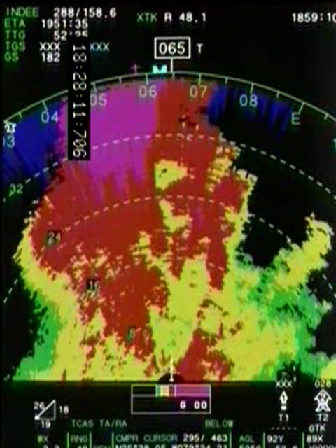
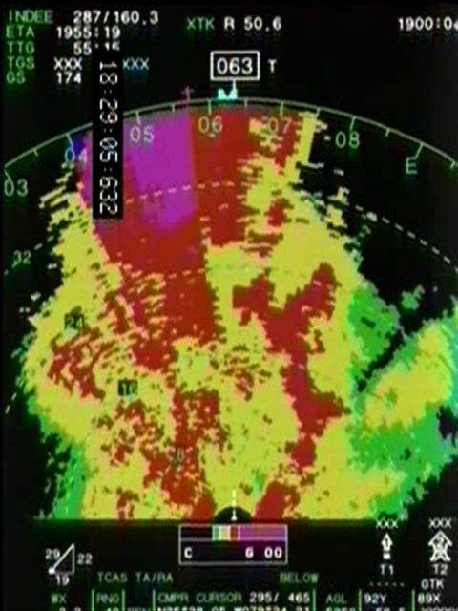
Non Coherent vs Coherent

Slide 7
Using New Functions
Tilt
  Applies to Weather Mode Only; all other modes are unchanged.
  Tilt angle is measured from the center of the beam height to the horizon (not bore sighted to the nose of the aircraft)
  Default tilt angle is 0 degrees
  At low altitude use > 3 degrees. The beam width is 3 degrees, but side lobes may cause some ground clutter.

Slide 8
Tilt
3 degrees
Tilt control is the same

Slide 9
GAIN
The Gain functionality has been changed
  The old Gain control simply adjusted the brightness of the display.
  The Gain switch now changes the range of the return levels displayed.
    Returns which are closer to Thermal Noise can be broken out.
  A pop-up window depicts the Gain offset from default.

Slide 10
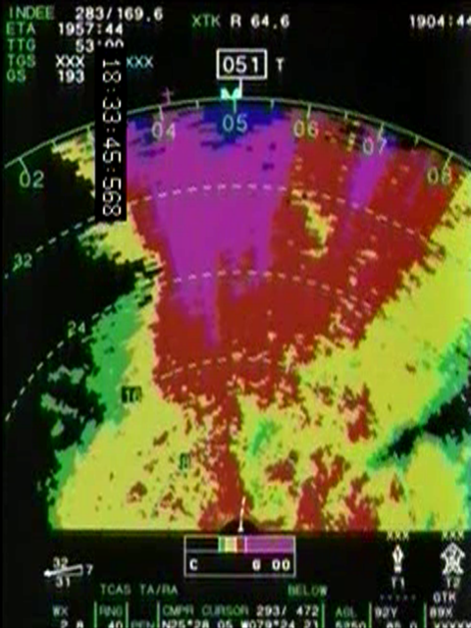
GAIN OFFSET POPUP WINDOW

Slide 11
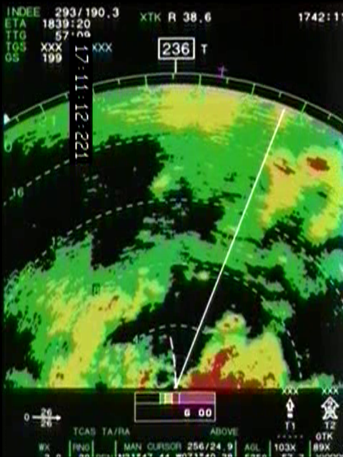
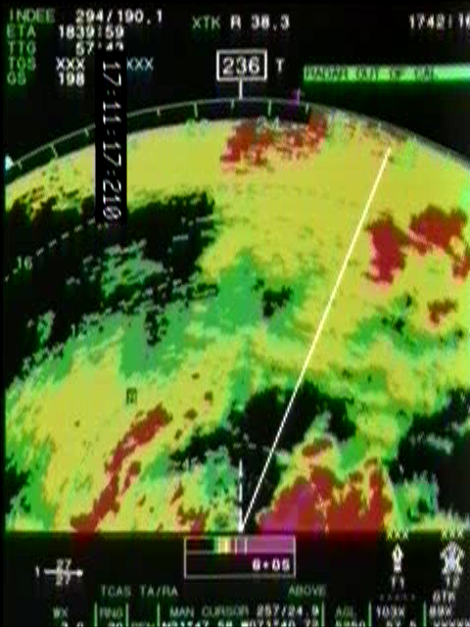
Increasing Gain
0 Gain Offset
+5 Offset

Slide 12
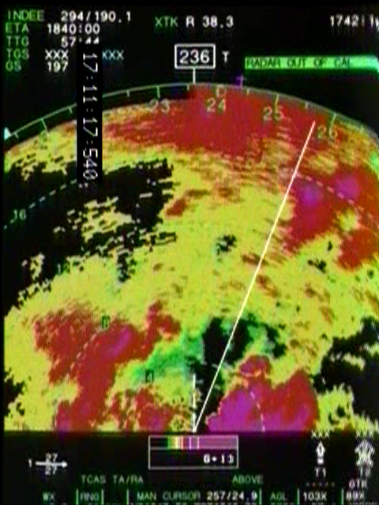
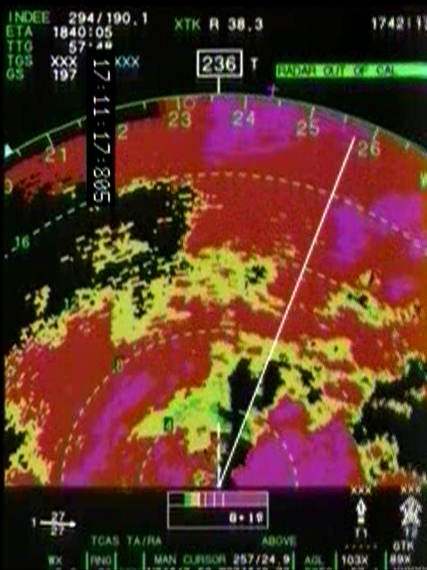
Increasing Gain
+ 11 Offset
+19 Offset

